Slide 1
The Ontology of Craniofacial Development and Malformation
James Brinkley (PI)
Onard Mejino
Todd Detwiler
Structural Informatics Group
University of Washington
Seattle
Tim Cox
Michael Cunningham
Seattle Children’s Research Institute

Slide 2
Goals
Create an ontology for use by FaceBase
Standardized terms
for annotation
retrieval by keyword search
Relations
representation of knowledge
to allow semantic integration

Slide 3
OCDM
Human
CHO
CHDO
CHMMO
CHZMO
CHMO
mappings
mappings
CH3MO
CHZ2MO
CET
Mouse
Zebrafish
CMO
CMZMO
CZO
CMDO
CZDO
mappings
CMMO
CMZ2MO
CZMO

Slide 4
Facebase 2 Milestones
Year
Task Dates
1. Conversion to OWL
a. CHO to OWL May 1, 2014 – Aug 1, 2014
b. OCDM to OWL June 1, 2014 – July 1, 2014
c. Review and Testing July 1, 2014 – Aug 1, 2014
d. Ongoing methodology Aug 1, 2014 – Ongoing
2. Canonical musculoskeletal system (MS) of head
a. CHO (Human) May 1, 2014 – Aug 31, 2014
b. CMO (Mouse) Sept 1, 2014 – Dec, 31, 2014
c. CZO (Zebrafish) Jan 1, 2015 – July 31, 2015
d. Termlists for Hub Feb 15, 2015 -- Ongoing
3. Embryonic development of MS of head
a. CHDO (Human) Aug 1, 2015 – Nov 30, 2015
b. CMDO (Mouse) Dec 1, 2015 – March 31, 2016
c. CZDO (Zebrafish) April 1, 2016 – Sept 30, 2016
4. Anatomy mappings
a. CHO with CMO (CHMMO) Oct 1, 2016 – Jan 31, 2017
b. CHO with CZO (CHZMO) Feb 1, 2017 – June 30, 2017
1
2
3

Slide 5
Topics
Craniofacial Zebrafish Developmental Ontology (CZDO)
Craniofacial Human Mouse Mapping Ontology (CHMMO)
Craniofacial Human Zebrafish Mapping Ontology (CHZMO)
Hub metadata terms
Ongoing Methodology
Year 4 plans and beyond
Potential Applications

Slide 6
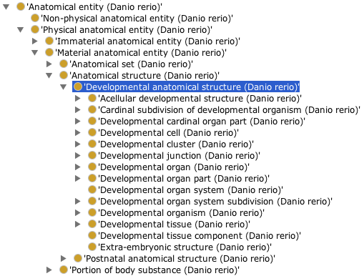
Craniofacial Zebrafish Developmental Ontology (CZDO)
- subset of Craniofacial Zebrafish Ontology

Slide 7
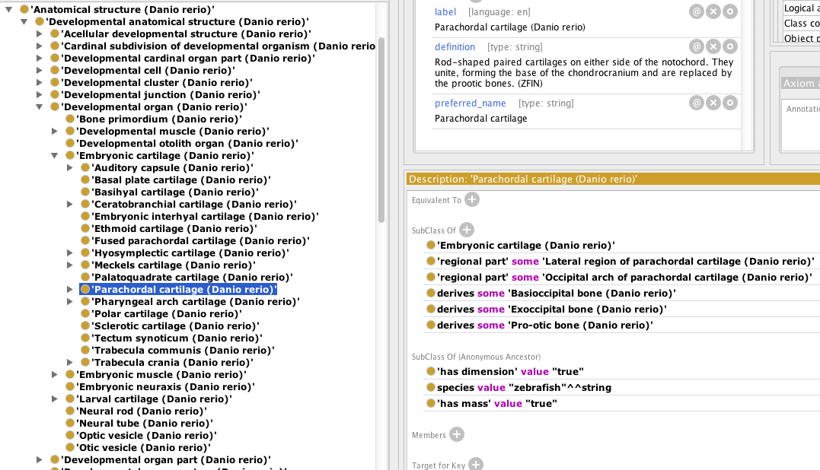
Craniofacial Zebrafish Developmental Ontology (CZDO)

Slide 8
Craniofacial Zebrafish Developmental Ontology (CZDO)

Slide 9
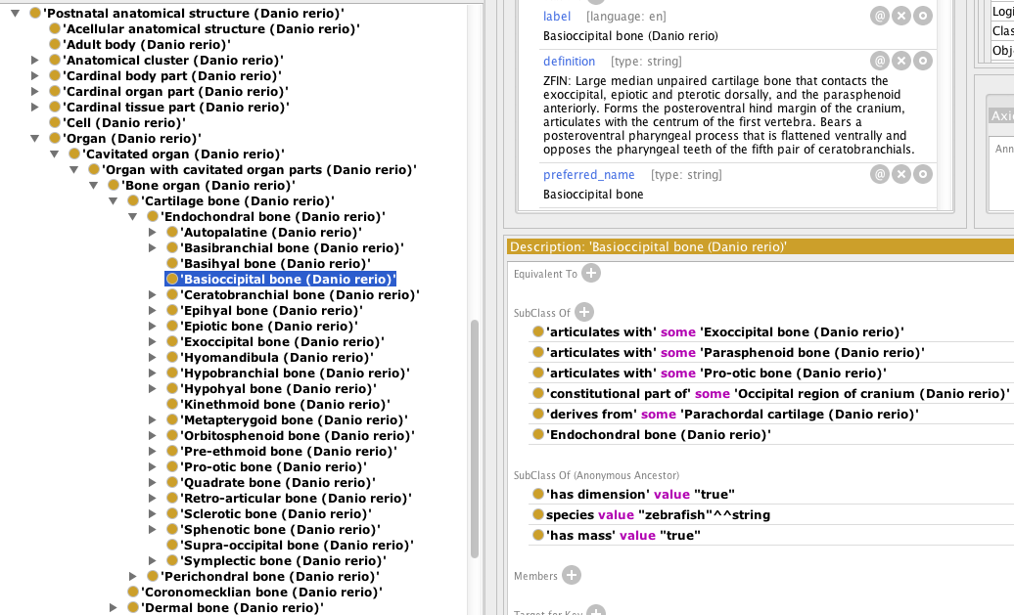
Craniofacial Zebrafish Developmental Ontology (CZDO)

Slide 10
Craniofacial Zebrafish Developmental Ontology (CZDO)

Slide 11
Topics
Craniofacial Zebrafish Developmental Ontology (CZDO)
Craniofacial Human Mouse Mapping Ontology (CHMMO)
Craniofacial Human Zebrafish Mapping Ontology (CHZMO)
Hub metadata terms
Ongoing Methodology
Year 4 plans and beyond
Potential Applications

Slide 12
Craniofacial Human Mouse Mapping Ontology (CHMMO)
Craniofacial Human Zebrafish Mapping Ontology (CHZMO)
CHMMO records human and mouse homology mapping
CHZMO records human and zebrafish homology mapping
Based on phenotypic structure: mainly at gross anatomical level
(except for structures early in development)
Mappings:
one-to-one bi-directional
one-to-null uni-directional
High vertebrate similarity in humans, mouse and zebrafish biological attributes
- provisional mappings based on similarities in existing nomenclature
Mapping validity based on:
- review by domain expert (Tim Cox - mouse)
- literature/publications

Slide 13
Bi-directional 1:1 Mapping
Skull
(Homo sapiens) CHO
1-1 mapping
Skull
(Mus musculus)
CMO
Skull
(Homo sapiens) CHO
1-1 mapping
Skull
(Danio rerio)
CZO

Slide 14
1:Null Mapping
Ø
(Mus musculus)
Uvula (Homo sapiens)
[CHO]
1-null mapping
Ø
(Danio rerio)

Slide 15
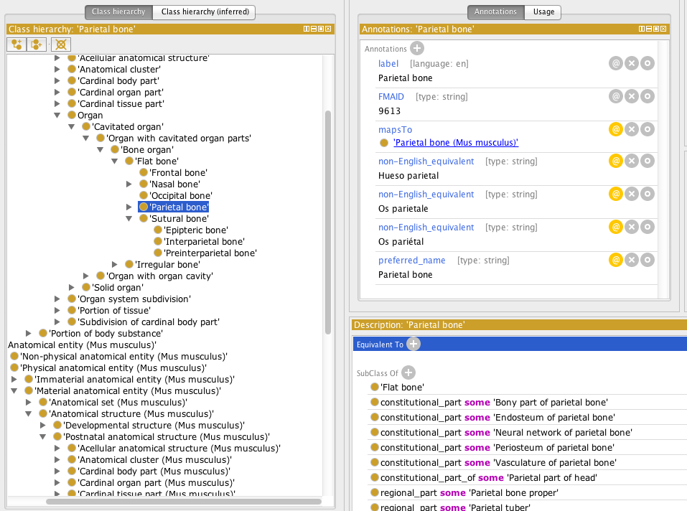
CHMMO in Protégé OWL

Slide 16
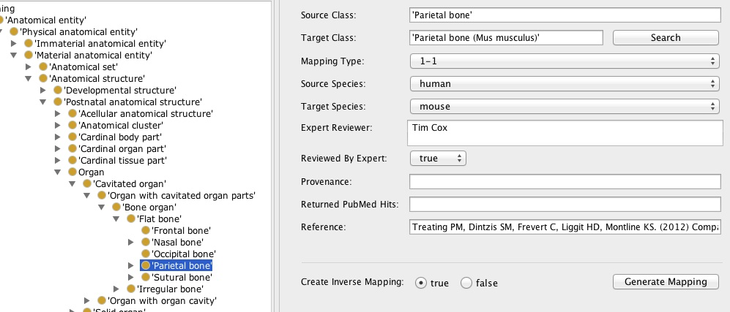
Human Parietal bone

Slide 17
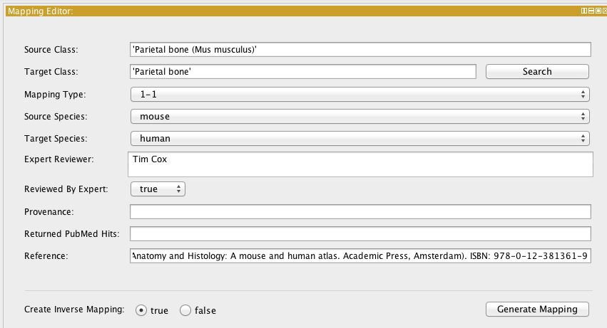
Mouse Parietal bone

Slide 18
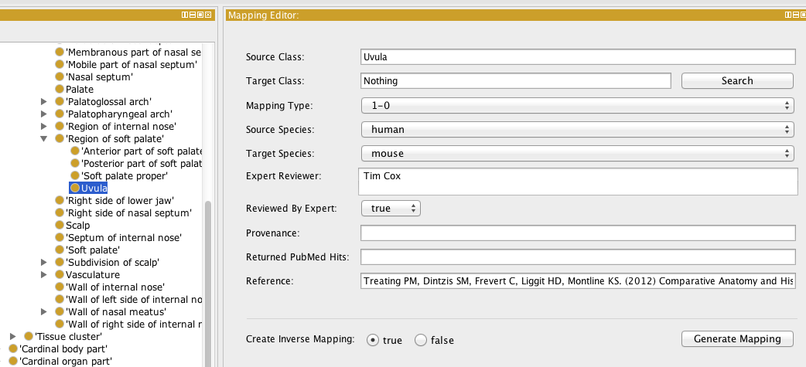
Human Uvula

Slide 19
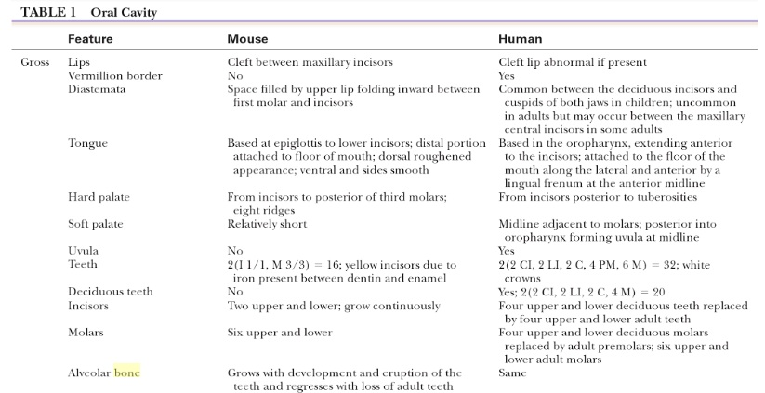
Treating PM, Dintzis SM, Frevert C, Liggit HD, Montline KS. Comparative Anatomy and Histology: A mouse and human atlas. Academic Press, Amsterdam, 2012). ISBN: 978-0-12-381361-9

Slide 20
1:Null Mapping
Ø
(Homo sapiens)
Intermolar eminence
(Mus musculus)
[CMO]
1-null mapping
Ø
(Homo sapiens)
Branchiostegal ray
(Danio rerio)
[CZO]
1-null mapping

Slide 21
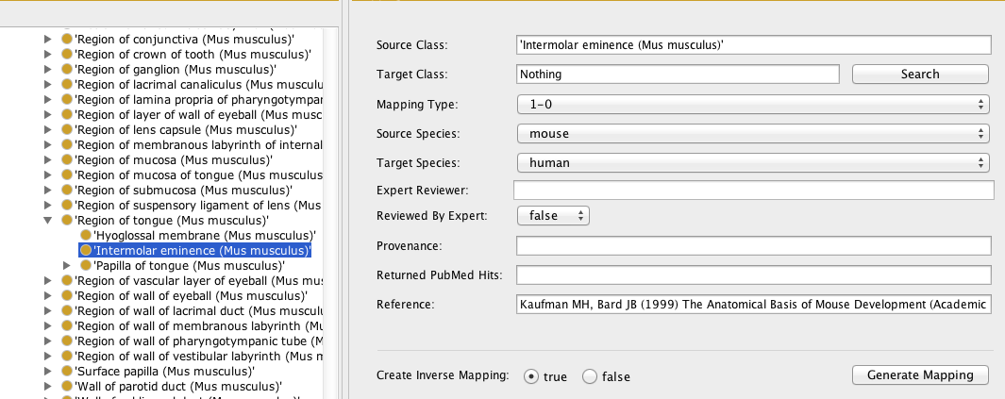
Mouse Intermolar Eminence

Slide 22
Gilbert SF (2000) Development Biology, 6th Edition (Sinauer Associates) ISBN-10: 0878932437
Y. Chai. Craniofacial development. (Academic Press, San Diego, 2015) ISBN: 978-0-12-408141-3 ISSN: 0070-2153
Rice DP. Developmental Anatomy of Craniofacial Sutures. Rice DP (ed): Craniofacial Sutures, Development, Disease and Treatment. Front. Oral Biol. Basel, Karger, 2008 vol 12, pp 1-21. (DOI:10.1159/000115028
J. Rossant, P.L. Tam. Mouse Development:Patterning, Morphogenesis and Organogenesis. (Academic Press, San Diego, 2002).
Lonai P. Mammalian Development. (Hardwood Academic publishers, Amsterdam 1996). ISBN 3-7186-5862-3
Hall B. Bones and Cartilage: Developmental and Evolutionary Skeletal Biology. (Academic Press, Amsterdam, 2005) ISBN 0-12-31906-06
Treating PM, Dintzis SM, Frevert C, Liggit HD, Montline KS. (2012) Comparative Anatomy and Histology: A mouse and human atlas. Academic Press, Amsterdam). ISBN: 978-0-12-381361-9

Slide 23
1:Many Mapping
Right frontal bone
(Mus musculus) [CMO]
Frontal bone (Homo sapiens) [CHO]
Posterior
frontal suture
(Mus musculus) [CMO]
Left frontal bone
(Mus musculus) [CMO]

Slide 24
1:1 Mapping
Right side of frontal bone (Homo sapiens) [CHO]
Right frontal bone
(Mus musculus) [CMO]
Metopic region of frontal bone
(Homo sapiens) [CHO]
Posterior
frontal suture
(Mus musculus) [CMO]
Left side of frontal bone (Homo sapiens) [CHO]
Left frontal bone
(Mus musculus) [CMO]

Slide 25
Mouse
Human
Right side of frontal bone
Right frontal bone
Frontal bone
Metopic region of frontal bone
Posterior frontal suture
Left left side of frontal bone
Left frontal bone
has part
1:1 mappings

Slide 26
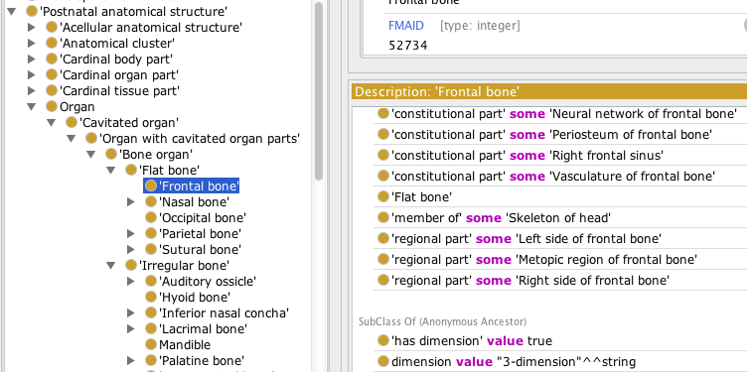
Human frontal bone

Slide 27
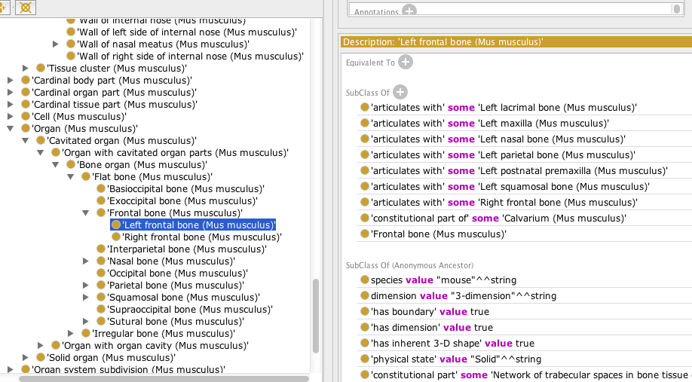
Mouse frontal bone

Slide 28
Stage-dependent mappings
Developmental stage
Human
Mouse
1:1 mapping
Right fetal frontal bone
Right embryonic frontal bone
1:1 mapping
Metopic suture
Posterior frontal suture
1:1 mapping
Left fetal frontal bone
Left embryonic frontal bone

Slide 29
Topics
Craniofacial Zebrafish Developmental Ontology (CZDO)
Craniofacial Human Mouse Mapping Ontology (CHMMO)
Craniofacial Human Zebrafish Mapping Ontology (CHZMO)
Hub metadata terms
Ongoing Methodology
Year 4 plans and beyond
Potential Applications

Slide 30
Metadata Annotation List
Anatomy
Specimen
Age/stage
Human (CHO, HDAA)
OBI
Human (CHO, Carnegie)
Mouse (CMO, MA, EMAP)
Mouse (CMO, Theiler, E-day)
Zebrafish (CZO, ZAO)
Zebrafish (CZO, ZFA)
FaceBase
metadata
Malformation phenotype
Human (CHMO, HPO, DO)
Species
NCBI taxonomy
Equipment/procedure
Mouse (CMMO, MPO)
OBI, RadLex, QIBO, FBbi

Slide 31
HUB metadata domains
DOMAINS No. of terms added
Species
Mouse strain 47
Specimen type
Anatomy
Human
Mouse 6
Zebrafish 2
Malformation phenotype
Human 1
Mammalian 7
Zebrafish 8
Developmental stage
Human 17
Mouse
Zebrafish 3
Developmental day
Human
Mouse
Imaging method/device

Slide 32
Topics
Craniofacial Zebrafish Developmental Ontology (CZDO)
Craniofacial Human Mouse Mapping Ontology (CHMMO)
Craniofacial Human Zebrafish Mapping Ontology (CHZMO)
Hub metadata terms
Ongoing Methodology
Year 4 plans and beyond
Potential Applications

Slide 33
OCDM to Queryable Resource
RDF Store
OCDM
Triple Store Builder

Slide 34
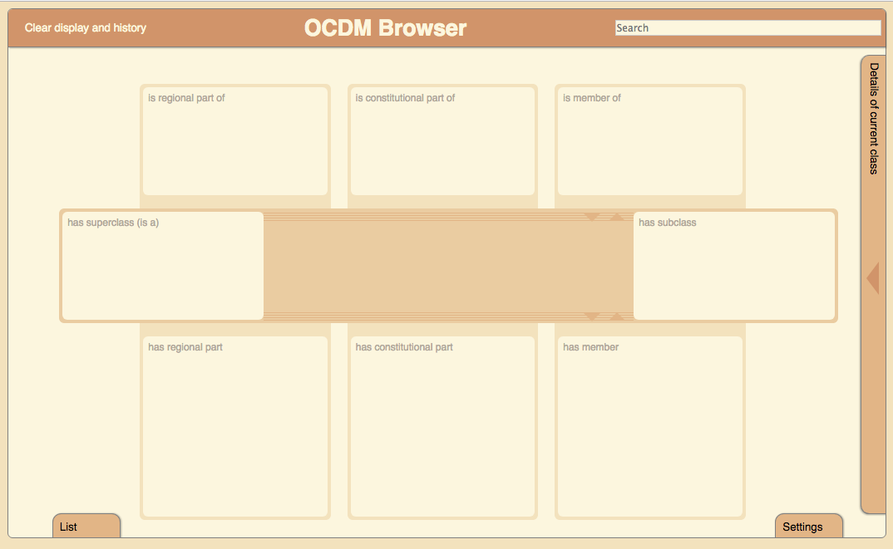
OCDM Browser
RDF Store
SparQL Endpoint
OCDM Browser

Slide 36
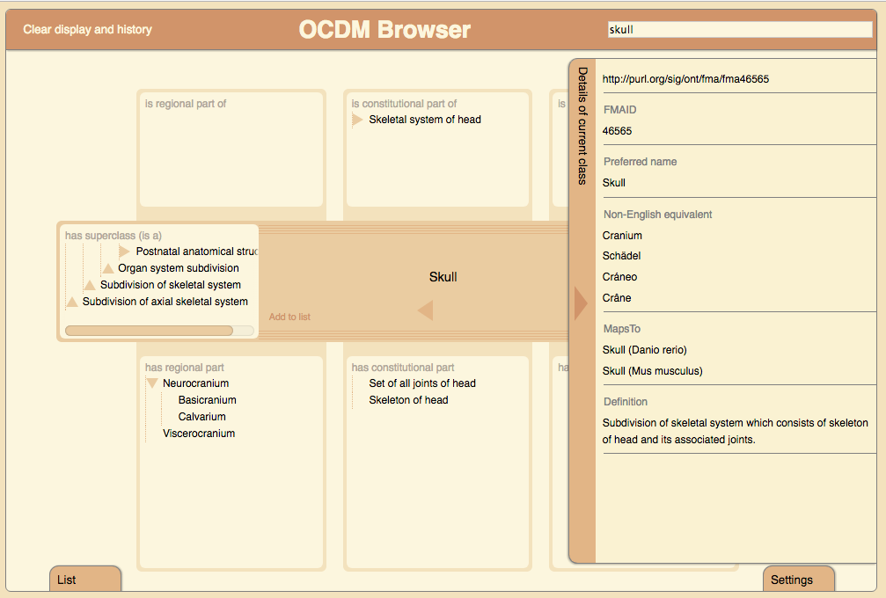

Slide 39
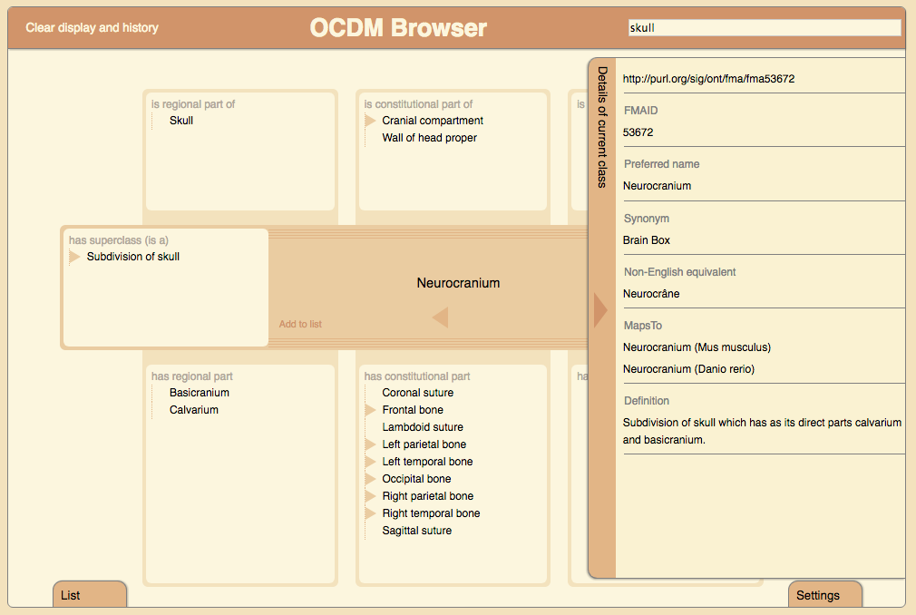

Slide 41
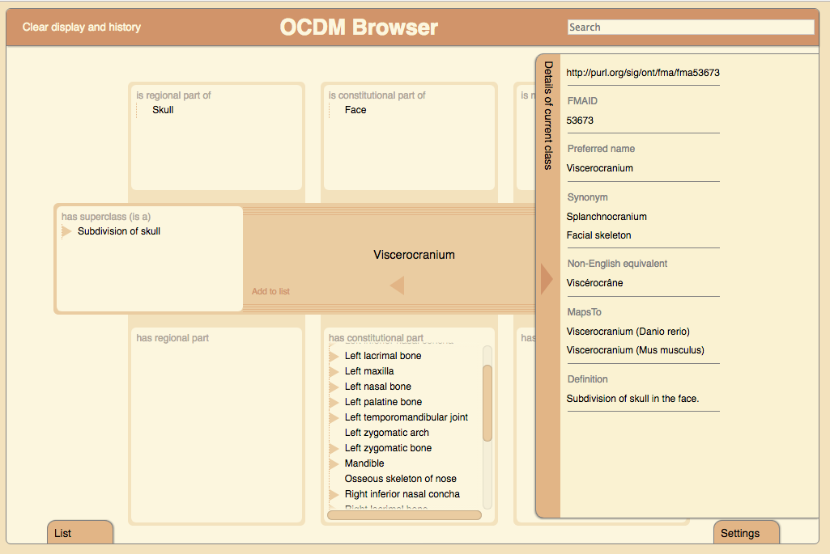

Slide 43
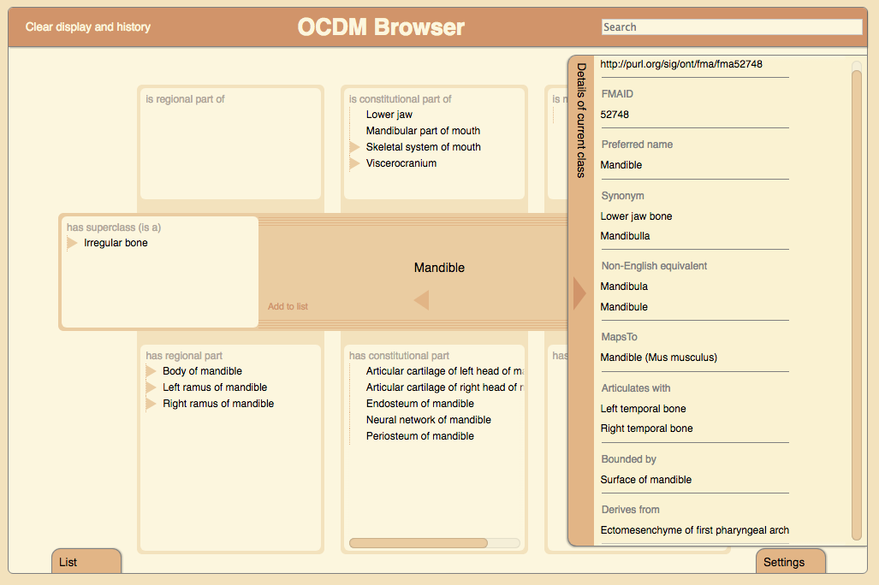

Slide 44
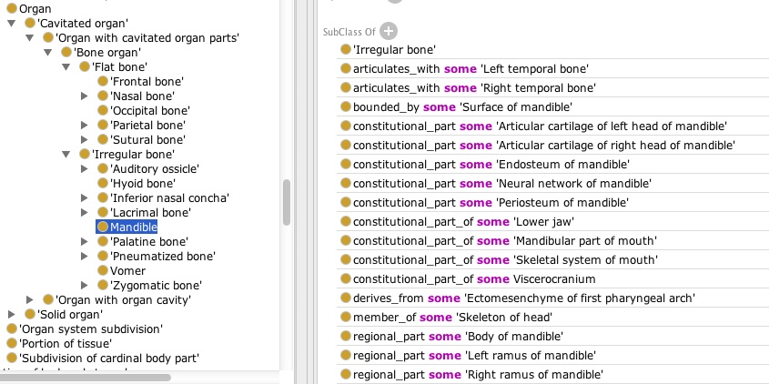
Human mandible

Slide 45
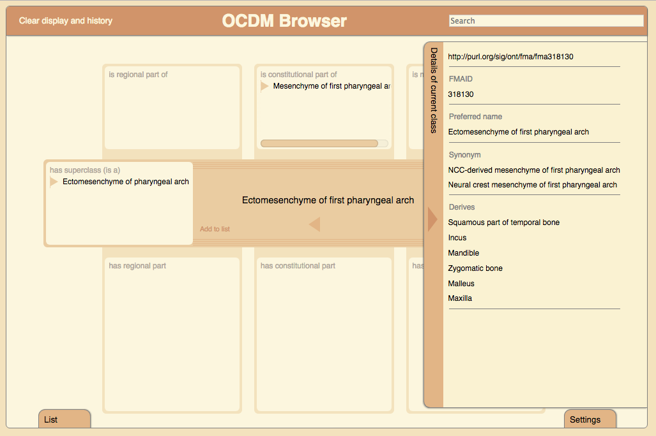

Slide 46
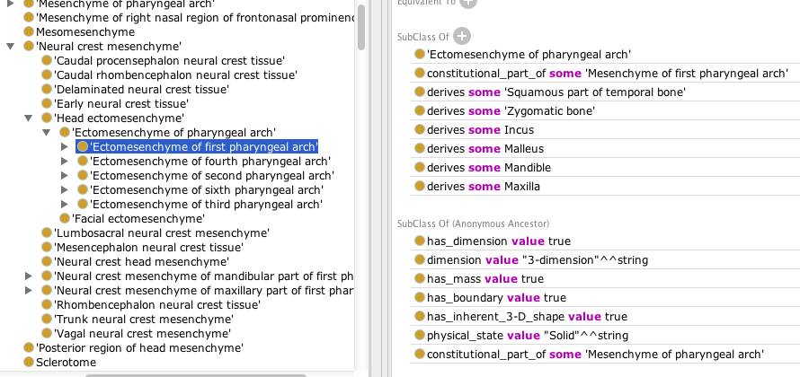
Human mandible

Slide 48
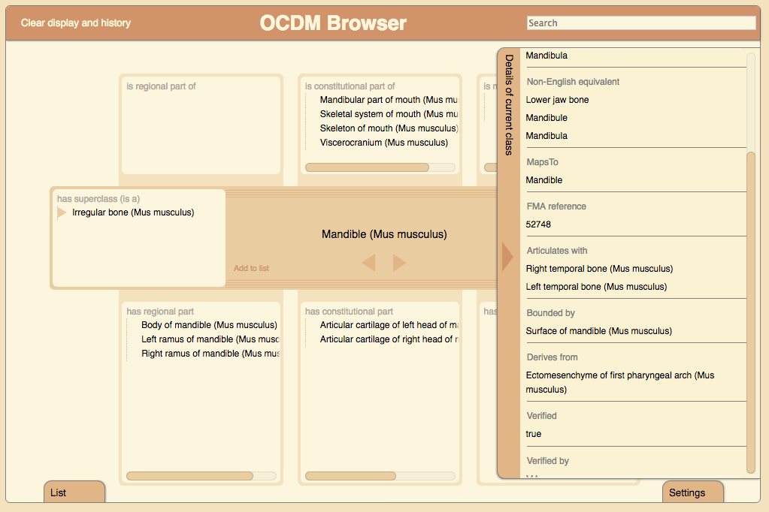

Slide 49
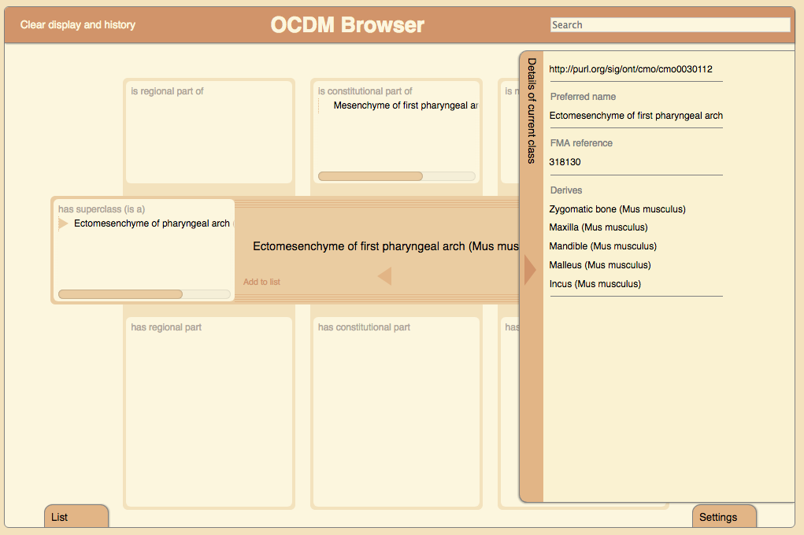

Slide 50
Topics
Craniofacial Zebrafish Developmental Ontology (CZDO)
Craniofacial Human Mouse Mapping Ontology (CHMMO)
Craniofacial Human Zebrafish Mapping Ontology (CHZMO)
Hub metadata terms
Ongoing Methodology
Year 4 plans and beyond
Potential Applications

Slide 51
Facebase 2 Milestones
Year
Task Dates
1. Conversion to OWL
a. CHO to OWL May 1, 2014 – Aug 1, 2014
b. OCDM to OWL June 1, 2014 – July 1, 2014
c. Review and Testing July 1, 2014 – Aug 1, 2014
d. Ongoing methodology Aug 1, 2014 – Ongoing
2. Canonical musculoskeletal system (MS) of head
a. CHO (Human) May 1, 2014 – Aug 31, 2014
b. CMO (Mouse) Sept 1, 2014 – Dec, 31, 2014
c. CZO (Zebrafish) Jan 1, 2015 – July 31, 2015
d. Termlists for Hub Feb 15, 2015 -- Ongoing
3. Embryonic development of MS of head
a. CHDO (Human) Aug 1, 2015 – Nov 30, 2015
b. CMDO (Mouse) Dec 1, 2015 – March 31, 2016
c. CZDO (Zebrafish) April 1, 2016 – Sept 30, 2016
4. Anatomy mappings
a. CHO with CMO (CHMMO) Oct 1, 2016 – Jan 31, 2017
b. CHO with CZO (CHZMO) Feb 1, 2017 – June 30, 2017
1
2
3

Slide 52
Future Milestones
Year
Task Date
5. Craniofacial malformation (facial and cranial vault dysmorphology)
a. CHMO (Human) July 1, 2017 – Nov 30, 2017
b. CMMO (Mouse) Dec 1, 2017 – March 31, 2018
c. CZMO (Zebrafish) April 1, 2018 – Aug 31, 2018
6. Malformation mappings
a. CHMO with CMMO Sept 1, 2018 – Dec 31, 2018
b. CHMO with CZMO Jan 1, 2019 – April 30, 2019
4
5

Slide 53
Topics
Craniofacial Zebrafish Developmental Ontology (CZDO)
Craniofacial Human Mouse Mapping Ontology (CHMMO)
Craniofacial Human Zebrafish Mapping Ontology (CHZMO)
Hub metadata terms
Ongoing Methodology
Year 4 plans and beyond
Potential Applications

Slide 54
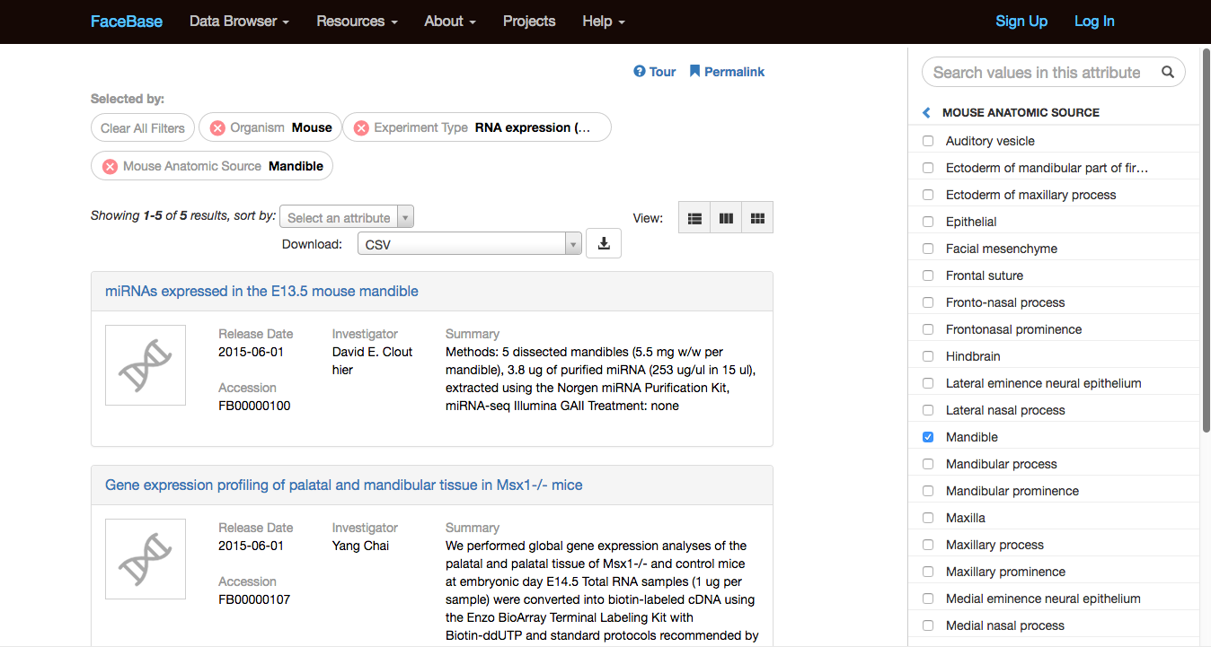
Link to OCDM Browser

Slide 55
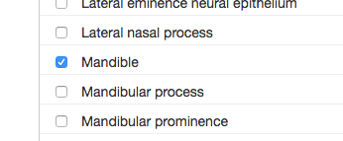

Slide 56
http://xiphoid.biostr.washington.edu/ocdm/browser/index.html?iri=http://purl.org/sig/ont/cmo/cmo0001129

Slide 58
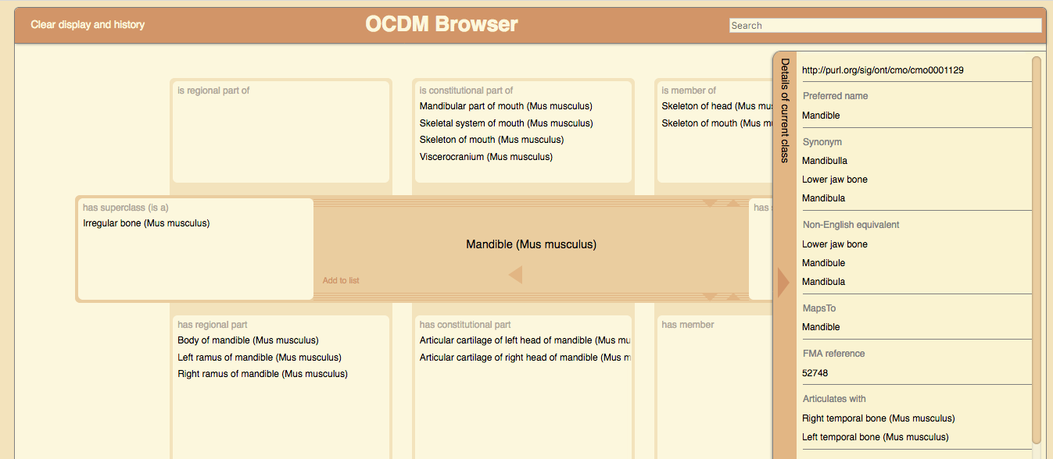
Annotate From OCDM Browser

Slide 59
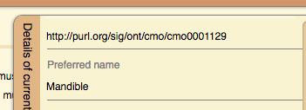

Slide 60
Personnel
Onard Mejino
Todd Detwiler
Tim Cox
Melissa Clarkson
Michael Cunningham

Slide 61
FaceBase interaction
Content development
Zebrafish (CZO) developmental structures and stages
Mathew Harris
Melissa Haendel (Monarch Initiative)
Yvonne Bradford (ZFIN curator)
Human-mouse mapping (CHMMO)
Greg Holmes
Pedro Sanchez (Y. Chai group)
Human-zebrafish mapping (CHZMO)
Matthew Harris

Slide 62
Links
Overview of OCDM
http://www.ncbi.nlm.nih.gov/pmc/articles/PMC4041627/
OCDM Browser
http://xiphoid.biostr.washington.edu/ocdm/browser/index.html
Obtaining the OCDM
https://www.facebase.org/ocdm/

