Slide 1

RNA dynamics in the developing mouse face
University of Colorado Anschutz Medical Campus
Joan Hooper, Hong Li, Kenneth Jones, Trevor Williams
FaceBase Annual Meeting
Boston, MA
5/1/2017

Slide 2
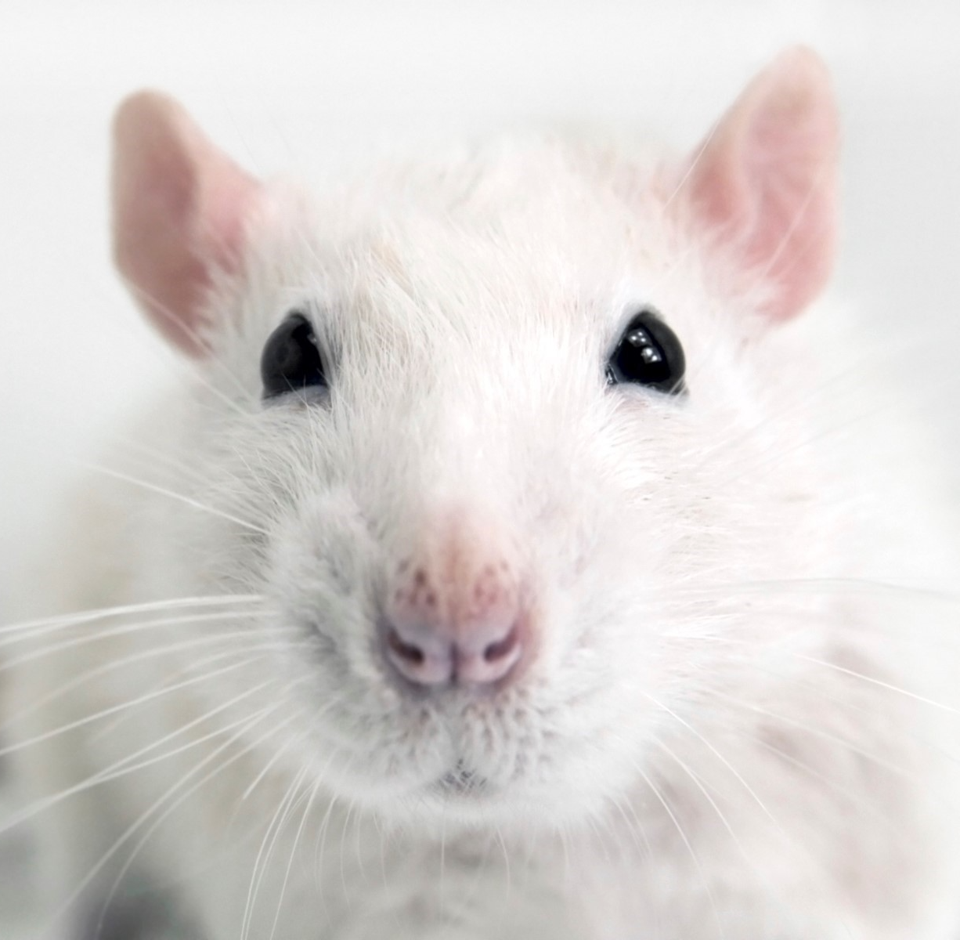
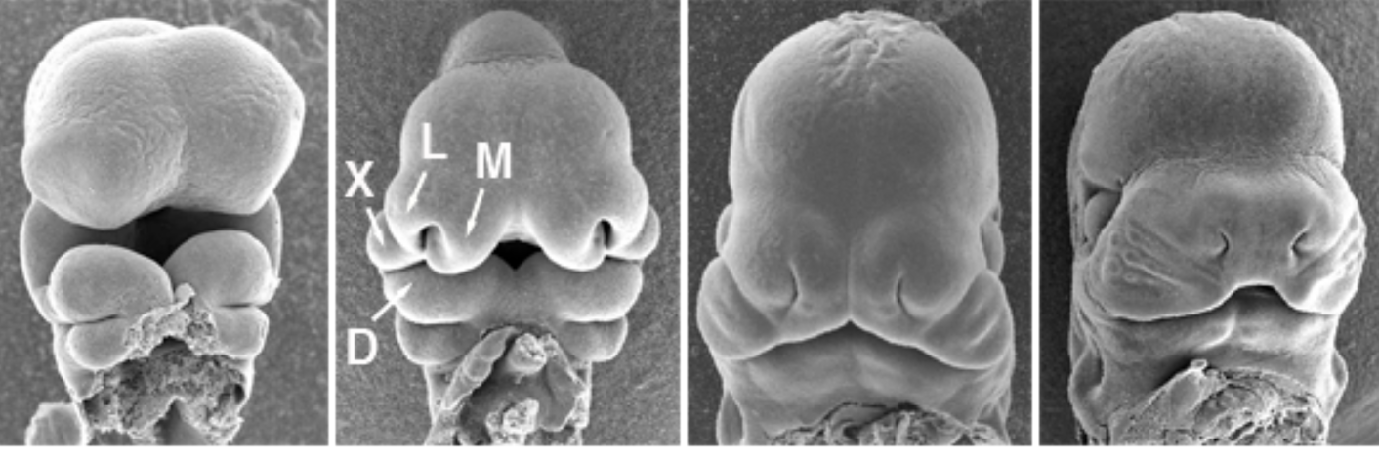

Describing the developmental programs
Aim 1: transcriptome
larger RNAs
smaller RNAs
Aim 2: isoform features
promoters (TSSs),
UTRs, splicing
Aim 3: translation
dynamics
mRNA stability
& localization
transcription regulatory networks
translation
regulatory networks
encoded
protein diversity
Integrate enhancer & promoter regulation, mRNA & small RNA abundances, UTR characteristics and translation rates to model regulatory networks and circuits that drive facial development.
Notes:
What are the genes and gene regulatory networks that enable the various tissues and prominences to give rise to different derivatives?
What isoform features distinguish the various tissues and prominences over time?
How might they affect facial development e.g. mRNA localization, translation dynamics, encoded proteins, etc?
Translation dynamics decode the latent infromation that dictates protein abundance. (including RNA BPs, small RNAs, UTR features, as well as ribosomal diversity, tRNAs, RNA modifications…
GRNs (Transcription) integrates our data with tons of public domain data including chromatin structure data from many groups, including Joanna’s and Axel’s, TF DChIP and motif
mRNA stability

Slide 3

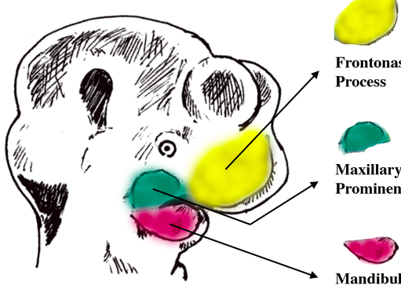
APPROACH
E10.5
Ect + Mes
FnP
E11.5
MxP
dispase
E12.5
MnP
RNA
or
ribosome-associated mRNAs
RNAseq
small RNA profiling
translation rates
Hong Li
Notes:
Helen!!!
everythng in triplicates

Slide 4
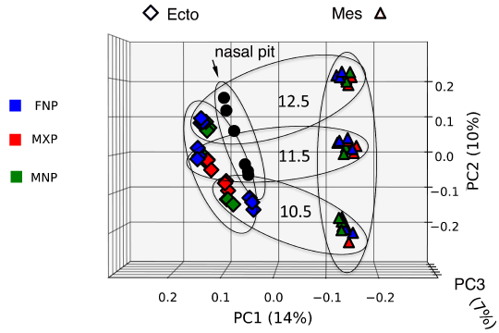
Aim 1a. Mouse face RNA-Seq is complete.
Principal component analysis:
replicates group by tissue layer, age and prominence.
~100M 125nt paired-end reads/sample x 60 samples provides ample depth for Aim 2 analysis.
Age
Tissue Layer
Hong Li & Ken Jones
Notes:
Replicates are tight
Most of the variance is due to tissue type: ECTO, MESEN, NASAL_EPI
second most variance is development time…with a tissue x time difference…that is MESEN is more differentiated, or less diverse…your choice
Lastly, there is variance explainable by substructure (FNP, MXP, MNP), but you have to analyze them separately to see it. You could show the individual PCAs to illustrate.

Slide 5
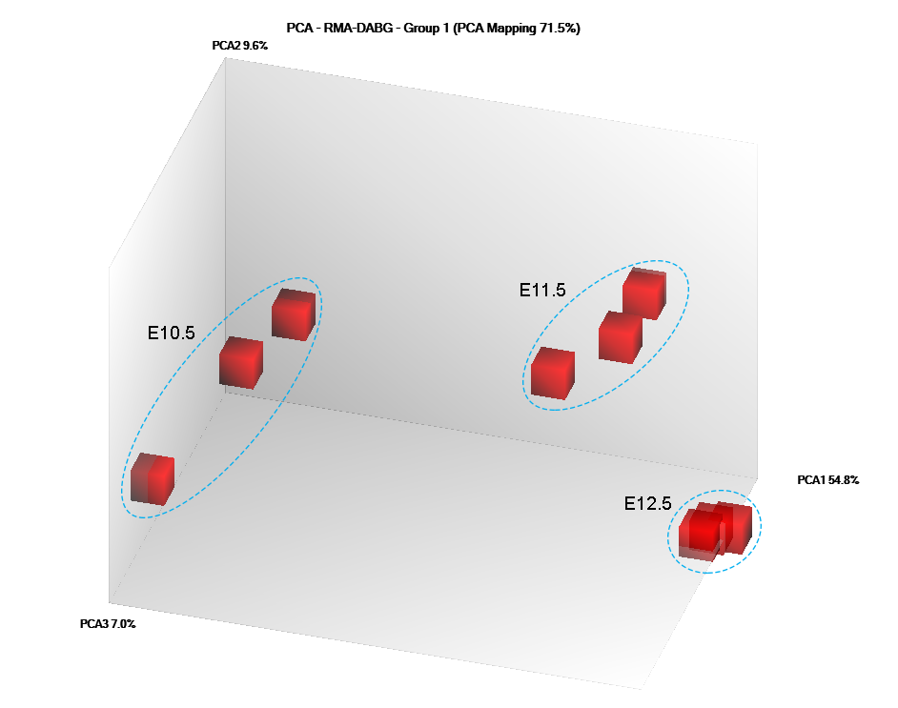
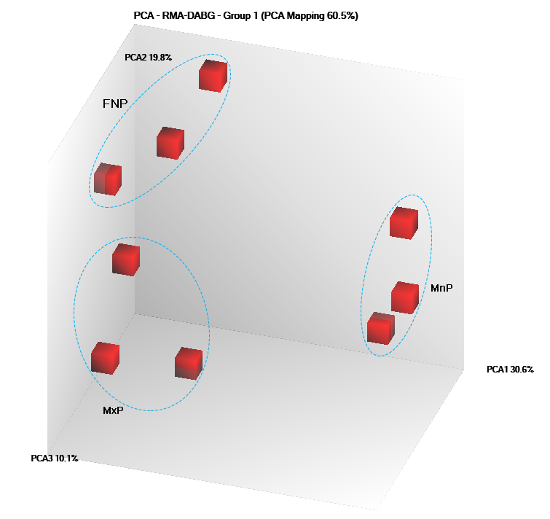
Aim 1b. mouse face small RNA profiling is complete
RNA type | # loci | detected* | DiffExp** | FC >=2 | # unique seq
miRNA | 1915 | 985 | 597 | 481 | 481
miRNA hairpin | 1277 | 337 | 172 | 43 | 43
sno & scaRNA | 1470 | 307 | 158 | 30 | 19
snRNA | 1385 | 942 | 483 | 86 | 29
tRNA | 504 | 355 | 224 | 171 | 36
rRNA | 422 | 305 | 194 | 0
total | 6973 | 3231 | 1828 | 811 | 608
mouse small RNA microarray:
Principal component analysis:
replicates group by age (Mx Mesenchyme) and by prominence (E10.5 Ectoderm)
Hong Li & Joan Hooper
Notes:
p <= 0.05 for DABG in at least 3 samples
** fdr <= 0.05

Slide 6
snoRNAs
Ect
Mes
10.5
11.5
12.5
10.5
11.5
12.5
Ect
Mes
10.5
11.5
12.5
10.5
11.5
12.5
Notes:
While the larger RNAs (mostly mRNAs) segregate primarily by tissue layer, the small RNAs seem to march to different drummers:also a subset of splicosomal U6 with preference for later Mes, etc and U1 with preference for

Slide 7
snoRNAs
snRNAs
(U6 & U1)
Ect
Mes
10.5
11.5
12.5
10.5
11.5
12.5
Ect
Mes
10.5
11.5
12.5
10.5
11.5
12.5
Notes:
also a subset of splicosomal U6 with preference for later Mes, etc and U1 with preference for

Slide 8
snoRNAs
snRNAs
(U6 & U1)
tRNAs
Ect
Mes
10.5
11.5
12.5
10.5
11.5
12.5
Ect
Mes
10.5
11.5
12.5
10.5
11.5
12.5
Notes:
also a subset of splicosomal U6 with preference for later Mes, etc and U1 with preference for

Slide 9
Describing the developmental programs
Aim 1: transcriptome
larger RNAs
smaller RNAs
Aim 2: isoform features
promoters (TSSs),
UTRs, splicing
Aim 3: translation
dynamics
mRNA stability
& localization
transcription regulatory networks
translation
regulatory networks
encoded
protein diversity
Notes:
A major motivator for Aim 1 was to have gene expression info to build transription regulatory networks.
But that also requires info about promotor usage (TSS usage)
A major motivator for the small RNA profiling was to have miRNA/mRNA regulatory networks- which requires info about 3’ UTR usage.
How big a deal is this? Ballpark ~half of mammalian genes have annotated alternative promoters. Ballpark ~ half of alternative transcription starts are unannotated.
Ballpark- similar diversity and lack of annotation at 3’ ends.
It also matters because
less than half of protein abundance is predicted by abundance of its encoding mRNA, and most of that disconnect is due to differneces in translation rates
UTRs have HUGE impact on miRNA regulatory repretoirs, translation rates, etc.
There is definitely potential for predicting protien abundances based on the LEVEL of the transript AND the flavor of its UTRs.

Slide 10
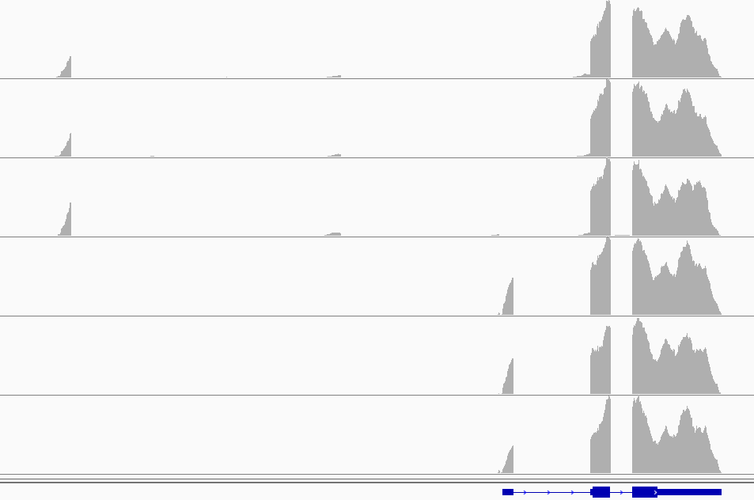
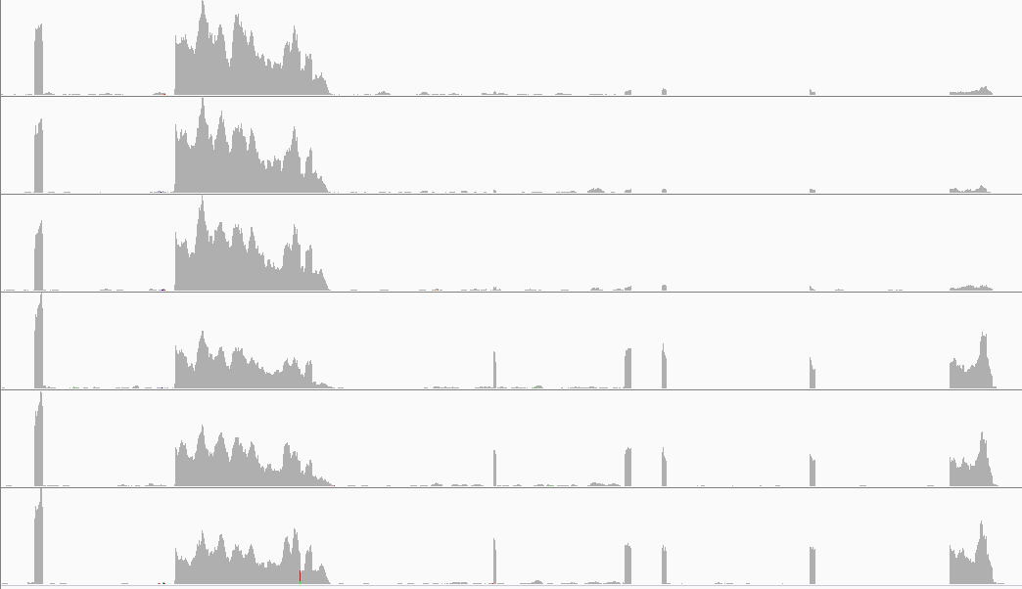
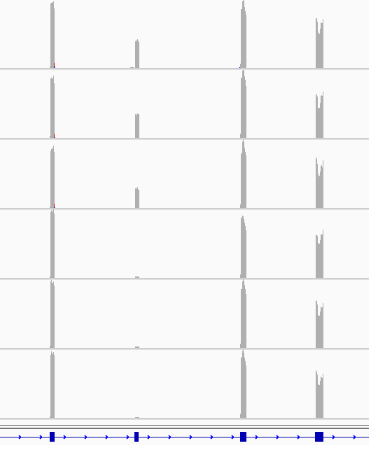
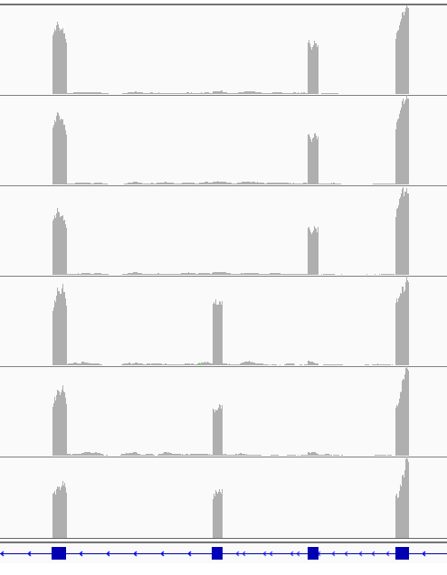
Aim 2: Differential splicing & UTRs
Differential
promoter
usage
S100a16
Differential
3’ end
usage
Lrrfip1
Ecto
…...........
Mes
Ecto
Differential
splicing
…............
Mes
Lef1
Fgfr2
the team
Notes:
what does that data actually look like – how to derive estimates of where the transcpts start and end, their UTRs, their alternative splicing?
How to actually measure/calculate the prevelance of specific isoform features?

Slide 11
a pipeline from RNASeq to splicing & UTRs
the problems:
CANT accurately reconstruct isoforms& their abundances from standard RNASeq data
Measuring alternative splicing or ends works much better with accurate gene models;
but MANY alternative splices and ends are not in the current gene models
standard RNASeq does NOT find transcript ends
the solutions:
IGNORE isoforms. Focus on exon and splice junction usage (which we can measure)
use tools that find NOVEL genes, exons and splices
use databases of TSSs and pA sites to estimate ends for novel genes and exons
incorporate novel genes, exons, splices and ends into an accurate face-gene model
Joan Hooper

Slide 12
a pipeline from RNASeq to splicing & UTRs
the problems:
CANT accurately reconstruct isoforms& their abundances from standard RNASeq data
Measuring alternative splicing or ends works much better with accurate gene models;
but MANY alternative splices and ends are not in the current gene models
standard RNASeq does NOT find transcript ends
the solutions:
IGNORE isoforms. Focus on exon and splice junction usage (which we can measure)
use tools that find NOVEL genes, exons and splices
use databases of TSSs and pA sites to estimate ends for novel genes and exons
incorporate novel genes, exons, splices and ends into an accurate face-gene model
ENSEMBL
gene models
FANTOM5
TSSs
Gruber
pA sites
spliced
ESTs
diff splice
estimates
promoter,
splicing &
UTR dynamics
face
RNASeq
data
Improved
gene models
diff exon
usage
estimates
Joan Hooper & Hong Li

Slide 13
Improved gene models for the mouse face: what we’ve found
 | ENSEMBL gtf | absent <0.01 FPKM | face gtf (known + novel)
genes | 48,795 | 10,429 | 43,358 (38,366 + 4,992)
txpts | 119,020 | 18,348 | 139,797 (98,684 + 41,113)
exons | 399,214 | 43,254 | 409,943 (355,960 + 43,252)
TSSs | 110,820 | 18,348 | 101,867 (66,888 + 34,979 )
pA sites |  |  | 105,625 (69,317 + 36,308)
Joan Hooper

Slide 14
4992 novel genes
> 1 sample; > 10 reads/sample; no overlap with exons of known genes
Joan Hooper
Notes:
3 classes of novel genes:
EST cluster/pseudogenes which tend to be longer, higher expression, are stranded and have more exons
other stuff which tend to be shorter, lower expression, unspliced, ambiguous strand
promoter-proximal short, single exon, low-expressed, oriented OPPOSITE to adjacent gene

Slide 15
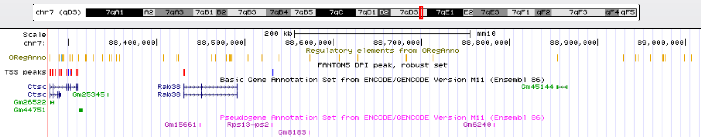
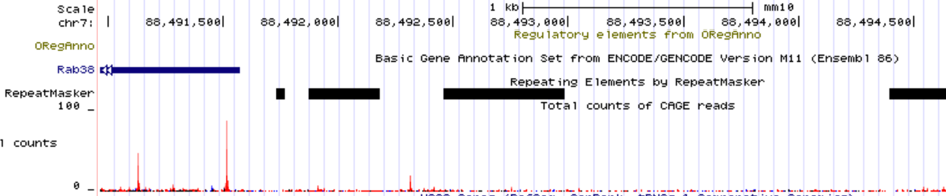
eRNA locus?
eRNA?
Joan Hooper
Notes:
MSTRG.25452 chr7 88493892 88494226 . NA 0.422552303 -2321 0.95 TRUE ENSMUSG00000030559 Rab38 protein_coding chr7 88430273 88491572 + 11.56540865
334 nt block

Slide 16
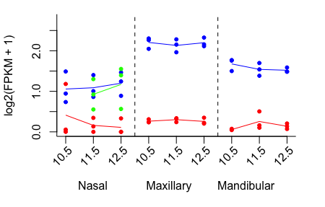
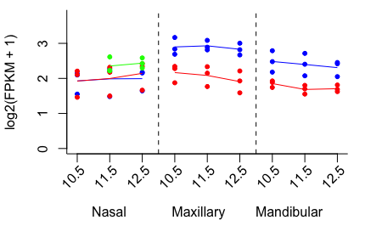
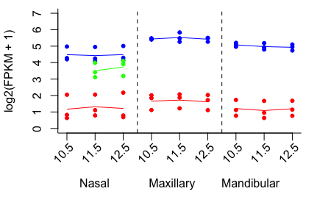
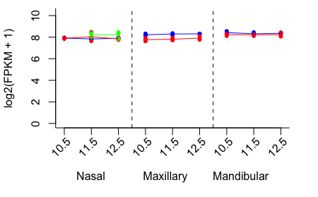
eRNA locus?
MS.25452
Ctsc
Rab38
Rps13-ps2
Notes:
MSTRG.25452 chr7 88493892 88494226 . NA 0.422552303 -2321 0.95 TRUE ENSMUSG00000030559 Rab38 protein_coding chr7 88430273 88491572 + 11.56540865
334 nt block

Slide 17
ENSEMBL
gene models
FANTOM5
TSSs
Gruber
pA sites
spliced
ESTs
diff exon
usage
estimates
promoter,
splicing &
UTR dynamics
face
RNASeq
data
Improved
gene models
diff splice
estimates

