Slide 1
E12.5 in situ validation
Nina Elder
Notes:
Before I get started, I just want to say that we have done this by RNA-seq and we are starting to validate the differences by qPCR and here RNA in situ hybridization to look at a particular gene with specific promoter expressed in the ectoderm (which is there) and another promoter which is used both in ectoderm and mesenchyme which you can see is expressed in both ectoderm and mesenchyme. Moving on.

Slide 2
Questions
Is differential exon usage important for facial development?
What is the alternative splicing program in facial development?
What are the regulators for the splicing program in facial development?
Notes:
Is differential exon usage important for facial development?

Slide 3
ESRP1 knockout causes orofacial clefting
WT ESRP1KO
ESRP (Epithelial Splicing Regulatory Protein )
Russ P Carstens. eLife 2015;4:e08954.
Notes:
Yes! It is! This is a gene called ESRP1, which is responsible for splicing in the epithelium and is very important in EMT and cancer. But the surprise was that when our collaborator Russ Carstens knocked it out. It had orofacial clefting, clefting lip and clefting palate. That shows splicing is critical for craniofacial development.

Slide 4
Questions
Is differential exon usage important for facial development?
Yes. It is!
What is the alternative splicing program in facial development?
What are the regulators for the splicing program in facial development?
Notes:
What is the splicing program? I will tell you about this in the first part of my talk. What are the regulators for this program. I will tell you in the second part of my talk.
So let’s go the the first part!

Slide 5
Differential Expression vs Alternative Splicing
FC >2 and p.adj < 0.01
FDR < 0.05 and |△PSI| > 10%
Alternative splicing is a major regulator of gene expression.
Comparison: E11.5 MXP Ect_vs_Mes
Notes:
Here I take the comparison of E11.5 MXP Ectoderm and Mesenchyme, looked at both differentially expression genes and alternatively spliced genes with various cutoffs. But the one I want to you to focus on is the △PSI, which is differences of percentage spliced in. The alternatively spliced genes are called by a program called rMATS, which was developed by Yi Xing in UCLA. What I want you to see here is that there are a lot of genes are differentially expressed, there is also a group of genes which are alternatively spliced. And there is only small portion of them overlap. Which means these genes are not regulated by level of expression, but are regulated by the level of splicing. That means that alternative splicing is a major regulator of gene expression during facial development. Let’s go look at that with more detail.
PSI : percentage spliced in.

Slide 6
Transcript strategies for diversification in facial development
Splicing type
First exon
Gene body
Last exon
Joan Hooper
Notes:
There are two things on this slides. Blue shows the differential usage between layers. Red shows the differential usage between ages. And green shows the differential usage between prominences. All three types of splicing are dominated by layer and age. Only a little differences between the prominences. The second thing is that although there is differential usage for first exon and last exon, most of the usage differences are in the body of the gene. Cause I am limited for time. I will focus on the gene body splicing events.

Slide 7
SE is the major splicing events
Gene body splicing events |  | Events number (up:down) | Gene number (up: down)
Skipping exon (SE) | 794 (500:294) | 656 (404:251)
Alternative 5’ splice site (A5SS) | 38 (19:19) | 38 (19:19)
Alternative 3’ splice site (A3SS) | 51 (35:16) | 50 (34:16)
Mutually exclusive exon (MXE) | 194 (91:103) | 160 (75:85)
Retained intron (RI) | 34 (14:20) | 30 (13:17)
Comparison: E11.5 MXP Ect_vs_Mes Cutoffs: FDR < 0.05 and |△PSI| > 10%
Notes:
There are five types of gene body splicing, I will not go through each of them. But it’s clear to see from the numbers on the right that the most dominant one is skipping exon in facial development. Therefore, I will focus on skipping exon on the rest of my talk.

Slide 8
SE events heatmap for facial development
Ect
Mes
10.5 | 11.5 | 12.5 | 10.5 | 11.5 | 12.5
FDR < 0.05 and |△PSI| > 10%
Notes:
I have done all the comparisons for alternative splicing between layers, ages and prominences using rMATS. I clusters the skipping exon events called in all the comparisons. Red shows higher inclusion. Blue shows lower inclusion. Three clusters stand out.

Slide 9
SE events heatmap for facial development
Cluster3
Mes higher PSI
Cluster1
Age difference
Cluster2
Ect higher PSI
Ect
Mes
10.5 | 11.5 | 12.5 | 10.5 | 11.5 | 12.5
FDR < 0.05 and |△PSI| > 10%

Slide 10
SE events heatmap for facial development
Cluster3
Mes higher PSI
Cluster1
Age difference
Cluster2
Ect higher PSI
Cluster3 GOTERM MF
GTPase activator activity
Cadherin binding involved in cell-cell adhesion
Guanyl-nucleotide exchange factor activity
Kinase activity
PDZ domain binding
Rab GTPase binding
Ect
Mes
-Log₁₀(Pvalue)
10.5 | 11.5 | 12.5 | 10.5 | 11.5 | 12.5
FDR < 0.05 and |△PSI| > 10%
Notes:
Let’s look at this with more detail. Let’s look at cluster 3.We did go term analysis.

Slide 11
SE events heatmap for facial development
Cluster3
Mes higher PSI
Cluster1
Age difference
Cluster2
Ect higher PSI
Cluster3 GOTERM MF
GTPase activator activity
Cadherin binding involved in cell-cell adhesion
Guanyl-nucleotide exchange factor activity
Kinase activity
PDZ domain binding
Rab GTPase binding
Ect
Mes
-Log₁₀(Pvalue)
10.5 | 11.5 | 12.5 | 10.5 | 11.5 | 12.5
FDR < 0.05 and |△PSI| > 10%
Notes:
What stands here is these GTPase associated proteins, which require for signal from the cell membrane to internal sites of cell, for example cytoskeleton. They are highly enriched in this cluster. This might give us an idea of what might happe mechanistically for alternative splicing.
GTPase activator activity: ARHGAP17, ARHGAP29, ECT2, DOCK4, DEPDC5, EVI5, GMIP, TBC1D13, GIT2, CHN1, DEPDC1A, EVI5L, RAPGEF2, TBC1D9B
guanyl-nucleotide exchange factor activity: SBF1, MADD, ARHGEF6, RAPGEF6, DENND1A, DOCK7, RAPGEF2, ECT2, DOCK6, DOCK4
GTPase binding: MYO5A, EVI5, TBC1D13, MICAL3, DENND1A, EVI5L, RABGGTB, TBC1D9B
I have told you about the alternative program in facial development. So what are the regulators of this program? I have told you about ESRP1. What about other regulators? I took universal known RNA binding proteins and checked how there are expressed in the face.

Slide 12
Expression of RBPs in face
Ect
Mes
10.5 | 11.5 | 12.5 | 10.5 | 11.5 | 12.5
p.adj < 0.01, FC >2

Slide 13
Expression of RBPs in face
Increase over age
Ect
Mes
10.5 | 11.5 | 12.5 | 10.5 | 11.5 | 12.5
p.adj < 0.01, FC >2
Notes:
Here you go. I can define clusters…….

Slide 14
Expression of RBPs in face
Increase over age
Ectoderm highly expressed
Ect
Mes
10.5 | 11.5 | 12.5 | 10.5 | 11.5 | 12.5
p.adj < 0.01, FC >2

Slide 15
Expression of RBPs in face
Increase over age
Ectoderm highly expressed
Mesenchyme highly expressed
Ect
Mes
10.5 | 11.5 | 12.5 | 10.5 | 11.5 | 12.5
p.adj < 0.01, FC >2

Slide 16
Expression of RBPs in face
Increase over age
Ectoderm highly expressed
Mesenchyme highly expressed
Decrease over ages
Ect
Mes
10.5 | 11.5 | 12.5 | 10.5 | 11.5 | 12.5
p.adj < 0.01, FC >2

Slide 17
Ectoderm enriched RBPs
ESRP1
Ect
Mes
10.5 | 11.5 | 12.5 | 10.5 | 11.5 | 12.5
Notes:
And now we will look at some of these clusters in more detail. This is the ectoderm enriched cluster. You see ESRP1 here.

Slide 18
Ectoderm enriched RBPs
Rbms1
Rbm47
ESRP1
Ect
Mes
10.5 | 11.5 | 12.5 | 10.5 | 11.5 | 12.5
Notes:
And we see a lot more RNA binding proteins other than ESRP1. I will get back to two of them later, Rbms1 and Rbm47.

Slide 19
Mesenchyme highly expressed RBPs
Ect
Mes
10.5 | 11.5 | 12.5 | 10.5 | 11.5 | 12.5

Slide 20
Mesenchyme highly expressed RBPs
Rbms3
Khdrbs2
Ect
Mes
10.5 | 11.5 | 12.5 | 10.5 | 11.5 | 12.5
Notes:
Rbms3 Osteonecrosis Of The Jaw

Slide 21
Motif enrichment for SE
Motifs enriched around exons with higher PSI in E11.5_MXP_Ect
Motifs enriched around exons with
higher PSI in E11.5_MXP_Mes
ESRP1
MBNL-1
RBMS3
SNRPA
ESRP1
KHDRBS2
MBNL-1
RBMS3
RBMS3
SNRPA
RBM47
RBMS1
RBMS3
ESRP1
RBMS3
RBM47
RBMS1
ESRP1
RBM47
SNRPA
ESRP1
RBM1
RBM47
Red: higher expressed in Ect
Blue: higher expressed in Mes
Notes:
So what then I did is taking the SE events, and cross reference them to the known RNA motifs in combine with expression level of RNA binding proteins, to come up with an idea of where these proteins bound during alternative splicing. Here is a typical skipped exon in green. This is the upstream exon and this is the downstream exon which are always included. I mapped ectodermal highly expressed RNA binding proteins in red, like ESRP1, and Mesenchymal highly expressed RNA binding proteins are in blue, like RBMS3, to these transcripts. We can see different regions of these transcripts which seems to be wholly enriched for these binding sites. Let’s look at this in more detail with ESRP1.

Slide 22
Motif map for ESRP1
Motif score for exons with higher PSI in Ect (lower PSI in Mes)
Motif score for exons with higher PSI in Mes (lower PSI in Ect)
Notes:
The peaks here shows ESRP1 binding sites with respect to the skipped exon as well as the upstream and down stream exons. But what does the blue and red mean? Well. The blue and red might show the different meaning in the Ectoderm and mesenchyme.

Slide 23
Diagram for ESRP1 in splicing
ESRP1 binding sites
ESRP1 protein
Skipping
Inclusion
Ect
Mes
Inclusion
Skipping
In agree with Russ P Carstens’s data in other systems: Mol. Cell. Biol. vol. 32 no. 8 1468-1482; eLife 2015;4:e08954; Cell Reports 15, 247–255.
Notes:
In the ectoderm, where ESRP1 is expressed, if it binds to the intron upsteam of the exon, it inhibits the inclusion of exon. You get exon skipping. However, if it binds downstream, you get inclusion of that exon. That’s why you see the red peak in the right side of the exon in the previous pictures. Because it’s included. However, in the mesenchyme, there is no ESRP1. These sites are not effective and there allow exon inclusion. But the downstream sites require ESRP1 to include the exon. But there is no ESRP1 in the mesenchyme. Therefore, the exon in skipped. That’s why we see a peak in blue for mesenchyme vs a peak in red for ectoderm because in one case is inhibiting in the ectoderm and in the other case it’s stimulating in the ectoderm. All of this is interesting. This agrees with Russ Carstons’ data for this protein in other context. What about other RNA binding proteins? Do they behave similarly or differently?

Slide 24
Diagram for ESRP1 in splicing
ESRP1 binding sites
ESRP1 protein
Skipping
Inclusion
Ect
Mes
Inclusion
Skipping
In agree with Russ P Carstens’s data in other systems: Mol. Cell. Biol. vol. 32 no. 8 1468-1482; eLife 2015;4:e08954; Cell Reports 15, 247–255.
Notes:
In the ectoderm, where ESRP1 is expressed, if it binds to the intron upsteam of the exon, it inhibits the inclusion of exon. You get exon skipping. However, if it binds downstream, you get inclusion of that exon. That’s why you see the red peak in the right side of the exon in the previous pictures. Because it’s included. However, in the mesenchyme, there is no ESRP1. These sites are not effective and there allow exon inclusion. But the downstream sites require ESRP1 to include the exon. But there is no ESRP1 in the mesenchyme. Therefore, the exon in skipped. That’s why we see a peak in blue for mesenchyme vs a peak in red for ectoderm because in one case is inhibiting in the ectoderm and in the other case it’s stimulating in the ectoderm. All of this is interesting. This agrees with Russ Carstons’ data for this protein in other context. What about other RNA binding proteins? Do they behave similarly or differently?

Slide 25
Motif map for RBMS3-[ACT]ATATA
Motif score for exons with higher PSI in Ect (lower PSI in Mes)
Motif score for exons with higher PSI in Mes (lower PSI in Ect)
Notes:
Here is a protein which is expressed higher in the Mesenchyme, RBMS3. Again, the peak show where the RNA binding motifs are. For ESRP1, the upstream peak is blue and the down steam is red. Now it’s reversed for RBMS3, which suggesting that this protein stimulates inclusion when it binds in the downstream intron.
That’s what we are now. There is a lot of data to sift through and understand. Hopefully we have give you an idea where we are going. In the last slides, we have the concludes of what we have talked today and where we are……

Slide 26
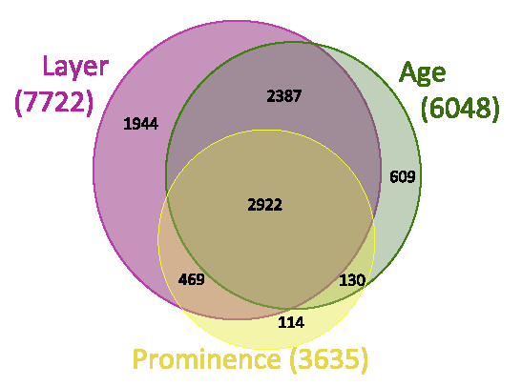
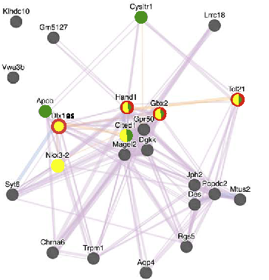
Conclusions
Aim 1: Transcriptome dynamics dataset
We have generated a comprehensive dataset to explore the gene expression networks defining mouse facial development across the dimensions of time, prominence and tissue layer for both mRNA and small regulatory RNA classes.

Slide 27
Conclusions
Aim2
Many genes are regulated through alternative transcripts rather than through differential expression.
We are developing new gene models relevant to facial development – new transcription start and polyA sites, new genes, transcripts, exons and splices.
We have characterized many alternative promoters that are differently used across the dataset – these can be mined with respect to the transcription factors binding sites, transcription factor expression and chromatin signatures to define facial GRNs.
We have characterized many alternative splices that are differently used across the dataset – which can be analyzed in the context of differentially expressed splicing factors to define facial splicing regulatory networks.
Ecto
Mes

Slide 28
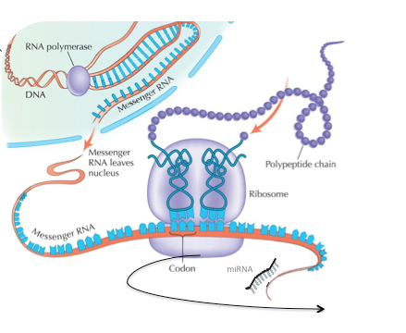
Conclusions
Aim3
We will characterize translation efficiency across facial development - then integrate with alternative splicing, UTR regulatory features and trans-acting regulatory factors (e.g. RNA binding proteins, miRNAs) to define a post transcriptional regulatory network relevant to the mechanisms of face formation.

