Slide 1
FaceBase Consortium
NIDCR Update
Steve Scholnick, PhD
TGRB/NIDCR/NIH

Slide 2
A reminder of why we’re here
Facilitate craniofacial research by making large, integrated datasets available to the wider scientific community
Develop the tools and datasets needed for a comprehensive, systems-wide, understanding of the developmental processes that create the face during embryogenesis and how those processes go awry.
We’re entering year 4 of these awards so time is of the essence

Slide 3
Update topics
Purpose of today’s webcast
Let those researchers watching the webcast know about types of data are/will be available, improvements to the FaceBase website, etc.
Additional funding opportunities for:
Using FaceBase data
Genetics/genomics research
Support for training
Gabriella Miller Kids First Initiative
Purpose and potential funding opportunities

Slide 4
Related FOA: PAR-16-36
NIDCR Small Research Grants for Secondary Analysis of FaceBase Data (R03)
Intended to encourage “outside” use of the data that you have produced and to encourage analyses that tie together data from different FaceBase projects
Larger than normal R03 budget
Direct costs of up to $200,000 per year are allowed with a maximum direct cost of $200,000 for the entire two year funding period
Not intended for support of data generation
Recipients of these grants are expected to share the results of their analyses through FaceBase

Slide 5
Craniofacial genetics-related R01 FOAs
PA-14-347: Building Genetics and Genomic Knowledge about Dental, Oral, and Craniofacial Diseases and Disorders (R01)
NIDCR contact: Emily Harris
PAR-17-236: Genetic Susceptibility & Variability of Human Structural Birth Defects (R01)
NIDCR contact: Steve Scholnick
​PAR-16-295/PA-16-296: ​Factors Underlying Differences in Female and Male Presentation for Dental, Oral, and Craniofacial Diseases and Conditions (R01/R21)​
NIDCR contact: ​​Preethi Chander

Slide 6
Craniofacial genetics-related R03 FOAs
PAR-16-070: NIDCR Small Research Grants for Data Analysis and Statistical Methodology Applied to Genome-wide Data (R03)
NIDCR contact: Emily Harris
PAR-16-323: Small Research Grants for Establishing Basic Science-Clinical Collaborations to Understand Structural Birth Defects (R03)​
NIDCR contact: Steve Scholnick

Slide 7
Training FOAs
PAR-14-039: Short-term Mentored Career Enhancement Award in Dental, Oral and Craniofacial Research for Mid-Career and Senior Investigators (K18)
NIDCR contact: Lynn King or Emily Harris
PA-16-193/PAR-16-156: NIH Pathway to Independence Award (Parent K99/R00)
NIDCR contact: Leslie Frieden

Slide 8
Gabriella Miller Kids First Initiative
Congressionally mandated NIH Common Fund Initiative examining the genomics of pediatric cancers and structural birth defects
https://commonfund.nih.gov/kidsfirst/overview
$12.6 million projected for each of 10 years
WGS of existing cohorts and development of a data resource
Cleft lip/palate cohorts
PAR-16-348: ​​Small Research Grants for Analyses of Data for the Gabriella Miller Kids First Data Resource (R03)​
NIDCR contact: Emily Harris

Slide 9
BD2K
The Data Discovery Index Coordination Consortium
http://biocaddie.org
Data Commons, pilot now running
BD2K Fundamentals of Data Science Series
http://www.bigdatau.org/data-science-seminars

Slide 10
NIDCR 2030
The NIDCR is looking for your input into its long term strategic planning in these areas:
Oral Health + Overall Health
Precision Health
Autotherapies
Oral Biodevices
Workforce Diversity
Please help us by posting your ideas for the future at https://nidcr2030.ideascale.com

Slide 11
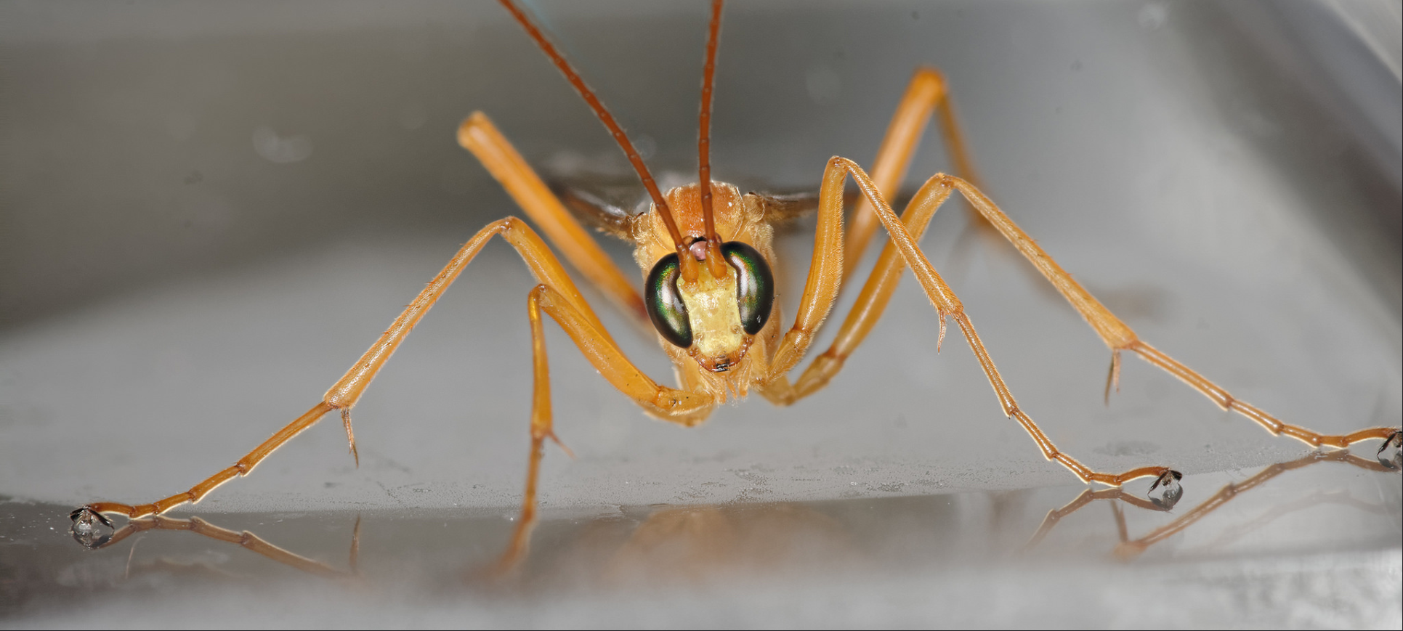
Any questions?

