Slide 1
The Ontology of Craniofacial Development and Malformation (OCDM)
James Brinkley (PI), Onard Mejino, Todd Detwiler
Structural Informatics Group, University of Washington
Tim Cox, Michael Cunningham
Craniofacial Center, Seattle Children’s Research Institute

Slide 2
Goals
Create an ontology for use by FaceBase and other craniofacial communities
Standardized terms
for annotation
retrieval by keyword search
Relations
to allow intelligent integration
representation of knowledge

Slide 3
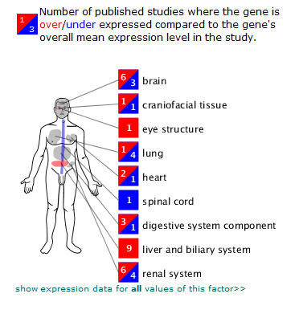
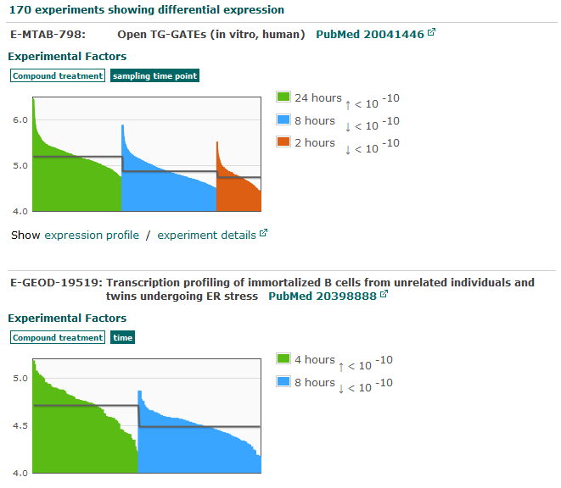
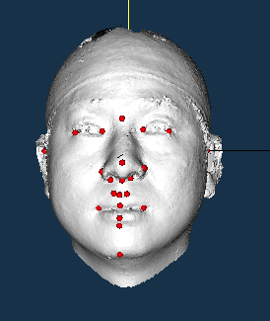
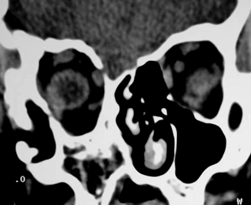
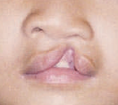
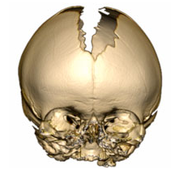
FaceBase
Repository
Genomic studies
Gene expression profiles
Medical imaging
Clinical studies and findings

Slide 4
OCDM for anatomical integration
Repository
Published genomic studies
OCDM
Gene expression profiles
Medical imaging
Clinical studies and findings

Slide 5
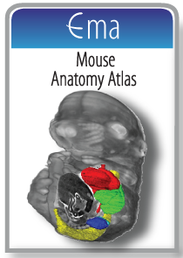
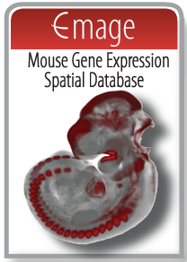
Other ontologies for other integration dimensions
Repository
Published genomic studies
OCDM
Gene expression profiles
Medical imaging
Clinical studies and findings
Model organisms
UBERON
Medical ontologies
Human Phenotype Ontology (HPO)
SNOMED-CT
ICD-10, ICD-11
Disease Ontology (DO)

Slide 6
Principles of the OCDM
Based on human anatomy and development
Foundational Model of Anatomy (FMA)
Utilizes existing ontologies as much as possible
Modular

Slide 7
OCDM
Human
CHO
CHDO
CHMMO
CHZMO
CHMO
mappings
mappings
CH3MO
CHZ2MO
Mouse
Zebrafish
CMO
CMZMO
CZO
CMDO
CZDO
mappings
CMMO
CMZ2MO
CZMO

Slide 8
OCDM
Human
CHO
CHDO
CHMMO
CHZMO
CHMO
mappings
mappings
CH3MO
CHZ2MO
Mouse
Zebrafish
CMO
CMZMO
CZO
CMDO
CZDO
mappings
CMMO
CMZ2MO
CZMO

Slide 9
OCDM
Anatomy
Craniofacial Human Ontology CHO
Craniofacial Human Development Ontology CHDO
Craniofacial Mouse Ontology CMO
Craniofacial Mouse Development Ontology CMDO
Craniofacial Zebrafish Ontology CZO
Craniofacial Zebrafish Development Ontology CZDO

Slide 10
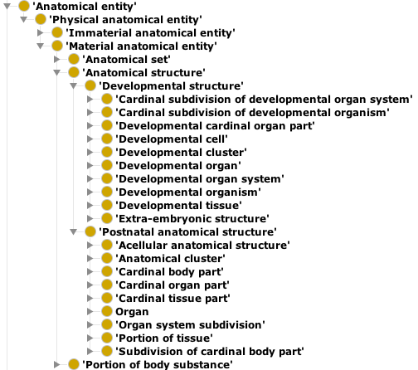
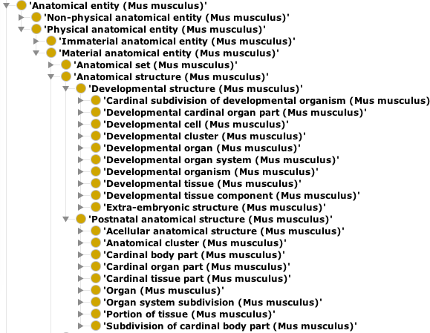
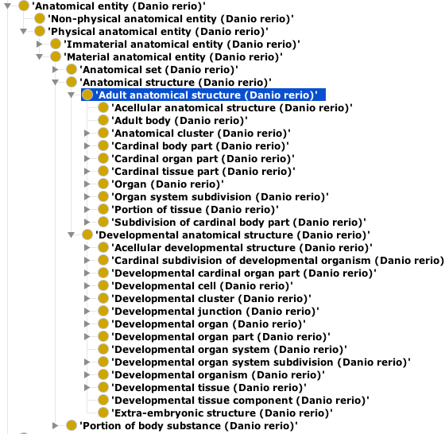
CHO (FMA)
CMO
CZO

Slide 11
CHO (FMA)
CMO
CHDO
CMDO
CZO
CZDO

Slide 12
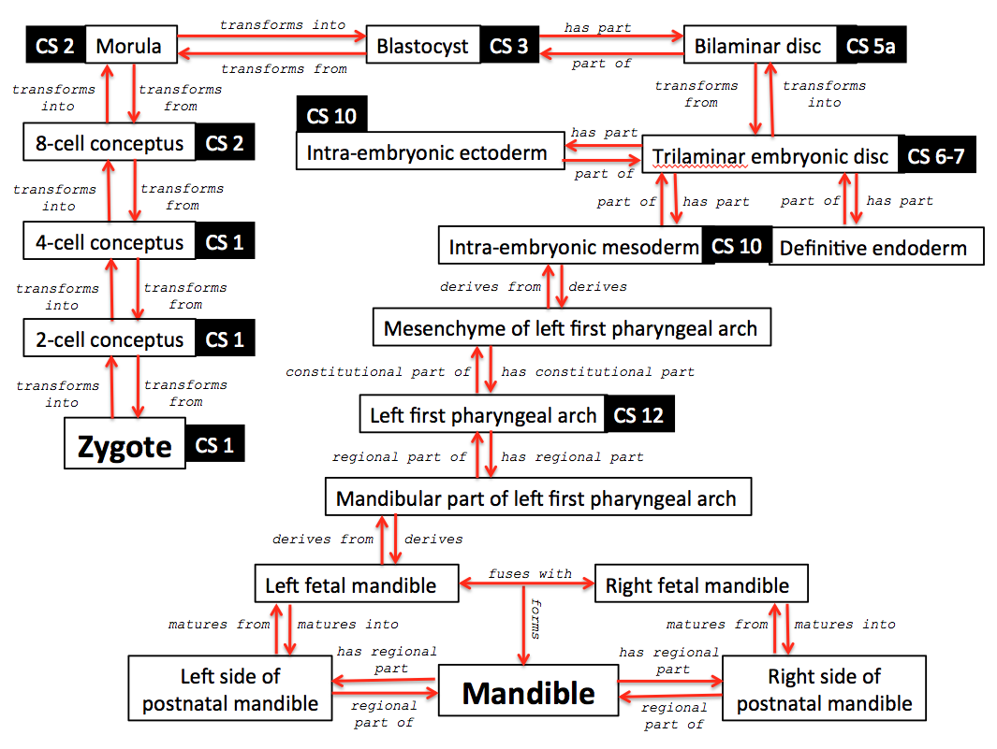

Slide 13
OCDM
Human
CHO
CHDO
CHMMO
CHZMO
CHMO
mappings
mappings
CH3MO
CHZ2MO
Mouse
Zebrafish
CMO
CMZMO
CZO
CMDO
CZDO
mappings
CMMO
CMZ2MO
CZMO

Slide 14
OCDM
Mappings (Homology)
Craniofacial Human Mouse Mappings Ontology CHMMO
Craniofacial Human Zebrafish Mappings Ontology CHZMO

Slide 15
Bi-directional 1:1 Mapping
Skull
(Homo sapiens) CHO
1-1 mapping
Skull
(Mus musculus)
CMO
Skull
(Homo sapiens) CHO
1-1 mapping
Skull
(Danio rerio)
CZO

Slide 16
1:Null Mapping
Ø
(Mus musculus)
Uvula (Homo sapiens)
[CHO]
1-null mapping
Ø
(Danio rerio)

Slide 17
1:Null Mapping
Ø
(Homo sapiens)
Intermolar eminence
(Mus musculus)
[CMO]
1-null mapping
Ø
(Homo sapiens)
Branchistegal
ray
(Danio rerio)
[CZO]
1-null mapping

Slide 18
1:many (uni-directional)
Right frontal bone
(Mus musculus) [CMO]
Interfrontal suture
(Mus musculus) [CMO]
Frontal bone (Homo sapiens) [CHO]
Left frontal bone
(Mus musculus) [CMO]

Slide 19
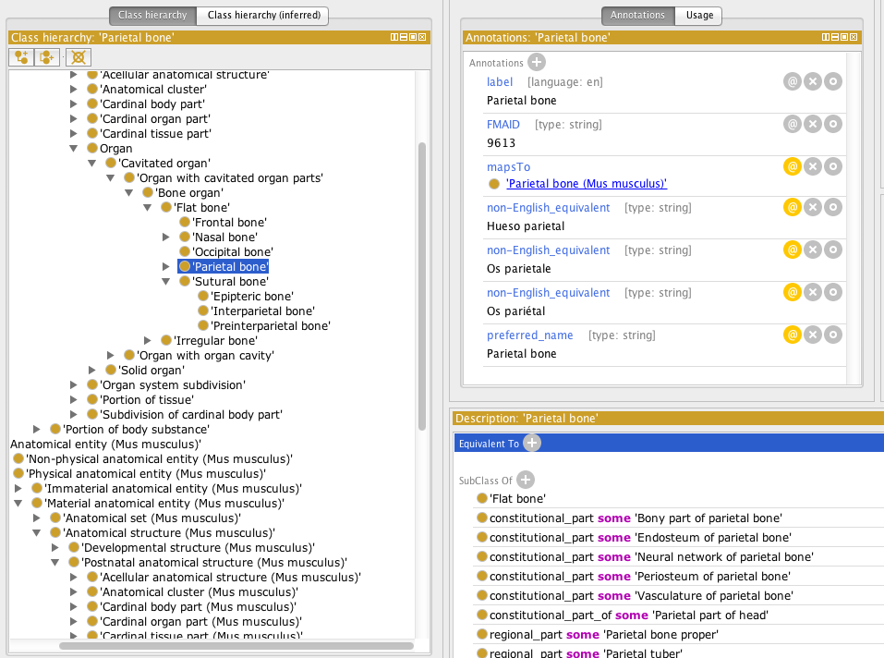
CHMMO in Protégé OWL

Slide 20
OCDM
Human
CHO
CHDO
CHMMO
CHZMO
CHMO
mappings
mappings
CH3MO
CHZ2MO
Mouse
Zebrafish
CMO
CMZMO
CZO
CMDO
CZDO
mappings
CMMO
CMZ2MO
CZMO

Slide 21
OCDM
Malformation
Craniofacial Human Malformation Ontology CHMO
Craniofacial Mouse Malformation Ontology CMMO
Craniofacial Zebrafish Malformation Ontology CZMO

Slide 22
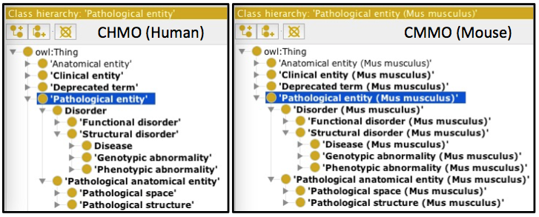

Slide 23
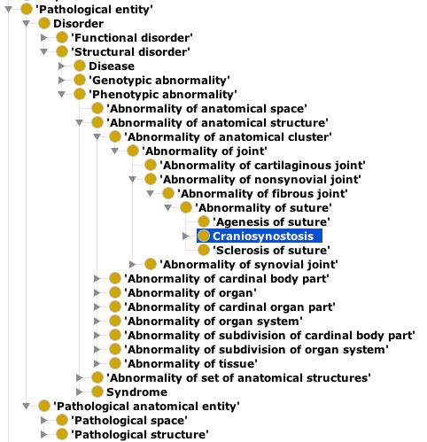
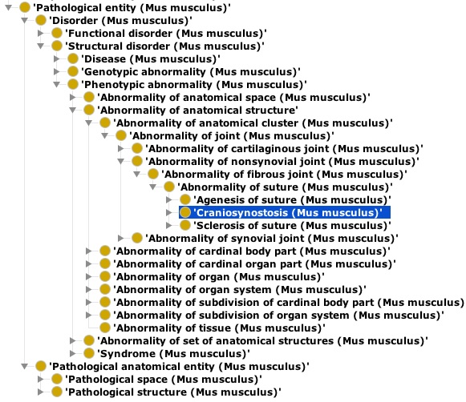
Pathological Entity: Craniosynostosis
CHMO (Human)
CMMO (Mouse)

Slide 24
OCDM
Human
CHO
CHDO
CHMMO
CHZMO
CHMO
mappings
mappings
CH3MO
CHZ2MO
Mouse
Zebrafish
CMO
CMZMO
CZO
CMDO
CZDO
mappings
CMMO
CMZ2MO
CZMO

Slide 25
OCDM
Mappings
Craniofacial Human Mouse Malformation Mappings Ontology CH3MO
Craniofacial Human Zebrafish Malformation Mappings Ontology CHZ2MO

Slide 26
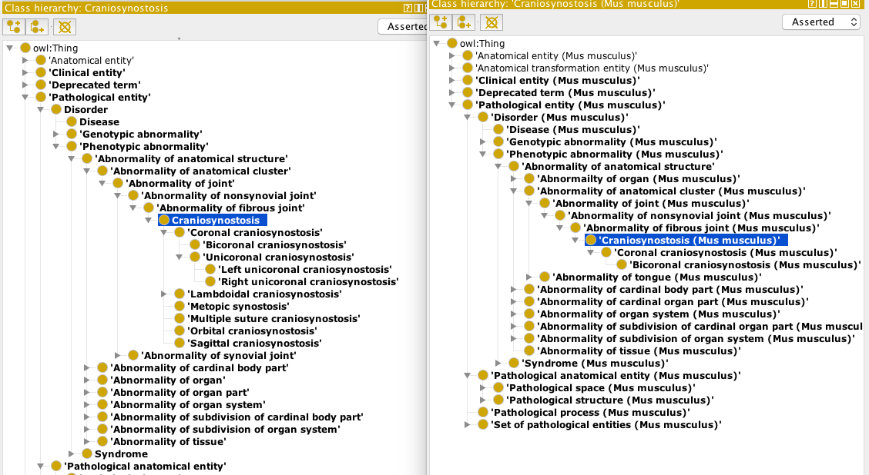
CH3MO
CHMO
CMMO

Slide 27
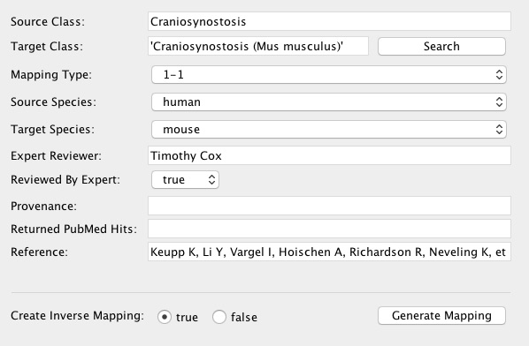

Slide 28
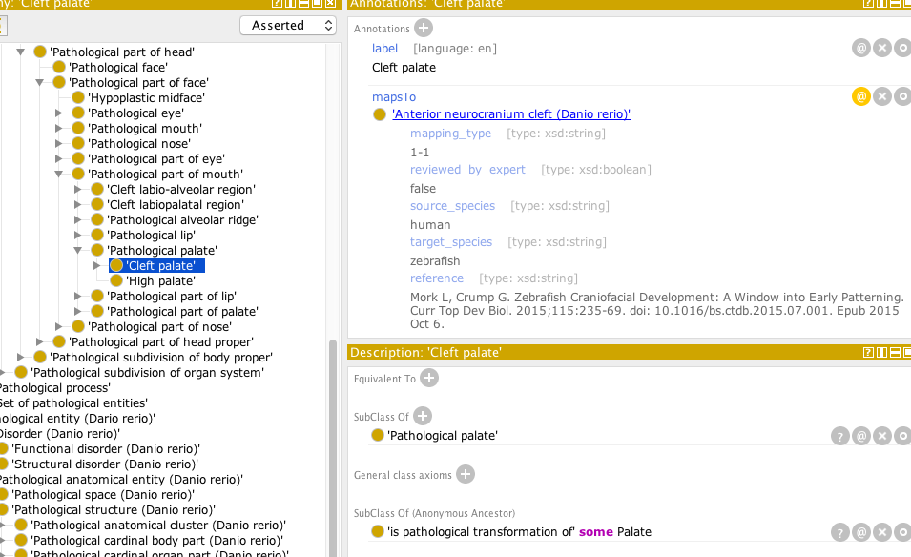
CHZMMO

Slide 29
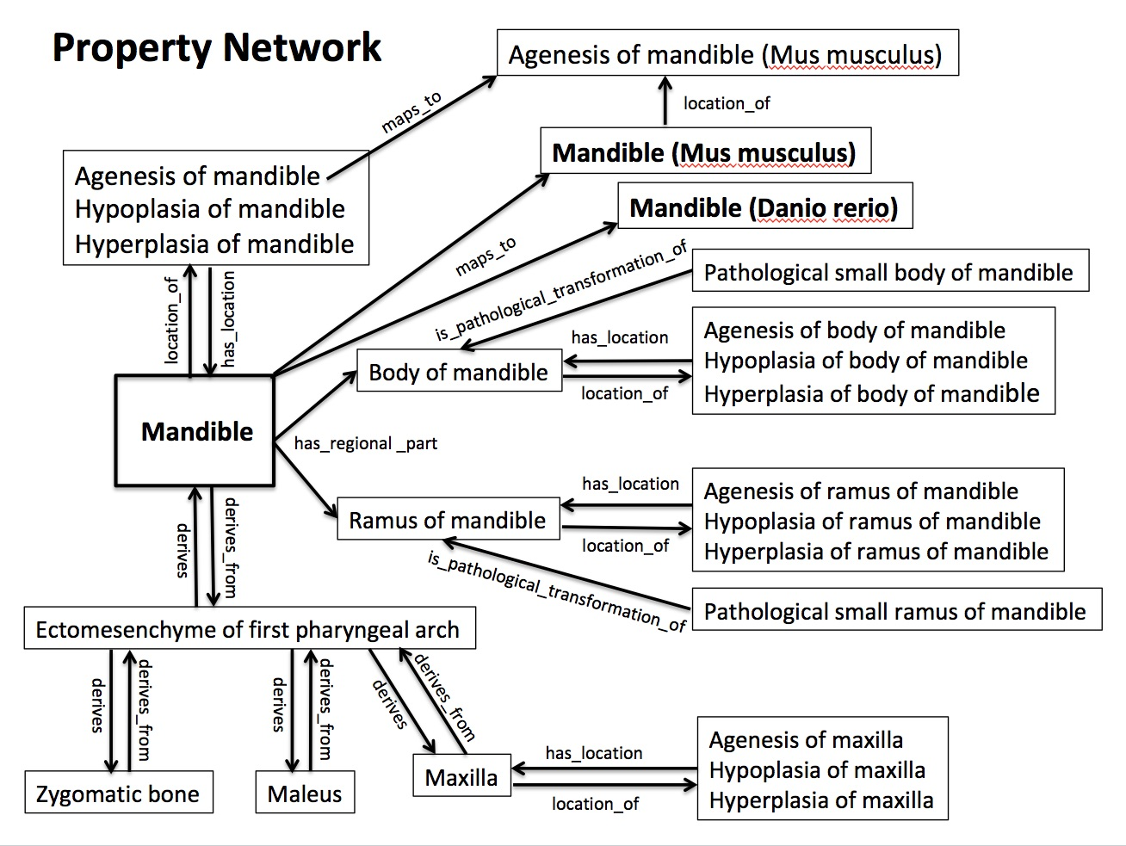

Slide 30
Milestones Years 1-3
Year
Task Dates
1. Conversion to OWL
a. CHO to OWL May 1, 2014 – Aug 1, 2014
b. OCDM to OWL June 1, 2014 – July 1, 2014
c. Review and Testing July 1, 2014 – Aug 1, 2014
d. Ongoing methodology Aug 1, 2014 – Ongoing
2. Canonical musculoskeletal system (MS) of head
a. CHO (Human) May 1, 2014 – Aug 31, 2014
b. CMO (Mouse) Sept 1, 2014 – Dec, 31, 2014
c. CZO (Zebrafish) Jan 1, 2015 – July 31, 2015
d. Termlists for Hub Feb 15, 2015 -- Ongoing
3. Embryonic development of MS of head
a. CHDO (Human) Aug 1, 2015 – Nov 30, 2015
b. CMDO (Mouse) Dec 1, 2015 – March 31, 2016
c. CZDO (Zebrafish) April 1, 2016 – Sept 30, 2016
4. Anatomy mappings
a. CHO with CMO (CHMMO) Oct 1, 2016 – Jan 31, 2017
b. CHO with CZO (CHZMO) Feb 1, 2017 – June 30, 2017
1
2
3

Slide 31
Milestones Years 4-5
Year
Task Date
5. Craniofacial malformation (facial and cranial vault dysmorphology)
a. CHMO (Human) July 1, 2017 – Nov 30, 2017
b. CMMO (Mouse) Dec 1, 2017 – March 31, 2018
c. CZMO (Zebrafish) April 1, 2018 – Aug 31, 2018
6. Malformation mappings
a. CHMO with CMMO Sept 1, 2018 – Dec 31, 2018
b. CHMO with CZMO Jan 1, 2019 – April 30, 2019
4
5

Slide 32
Potential Uses
Representation of knowledge
Like pathway databases
Data integration through knowledge
Controlled terms
Knowledge-based queries

Slide 33
Controlled Terms
Anatomy
Specimen
Age/stage
Human (CHO, HDAA)
OBI
Human (CHO, Carnegie)
Mouse (CMO, MA, EMAP)
Mouse (CMO, Theiler, E-day)
Zebrafish (CZO, ZAO)
Zebrafish (CZO, ZFA)
FaceBase
metadata
Malformation phenotype
Human (CHMO, HPO, DO)
Species
NCBI taxonomy
Equipment/procedure
Mouse (CMMO, MPO)
OBI, RadLex, QIBO, FBbi

Slide 34
Facilitating knowledge-based queries
Infrastructure for creating and delivering the OCDM
Making the OCDM queryable over the web
OCDM Browser Version 2
Proof-of-concept potential uses for the OCDM

Slide 35
Making the OCDM queryable over the web
RDF Store
SparQL Endpoint
OCDM
Triple Store Builder

Slide 36
OCDM Browser (version 2)
RDF Store
SparQL Endpoint
Other resources

Slide 37
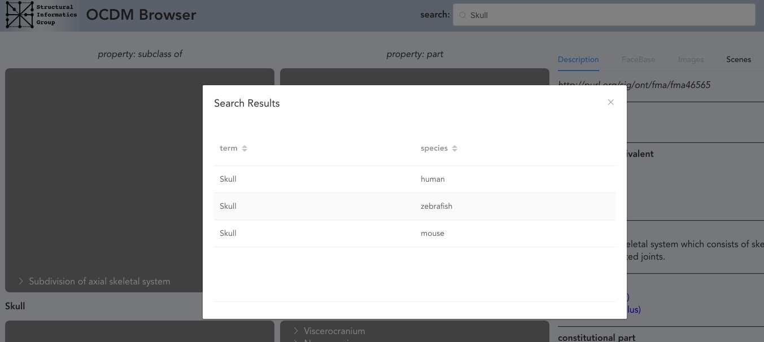

Slide 38
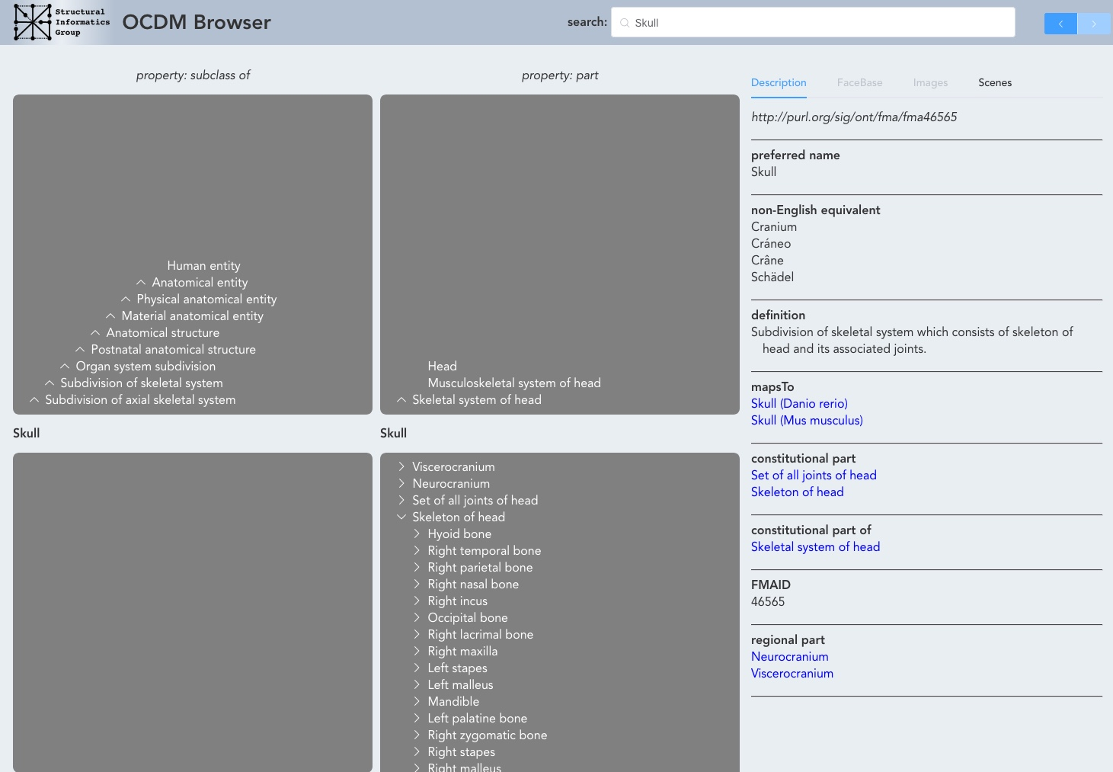

Slide 40
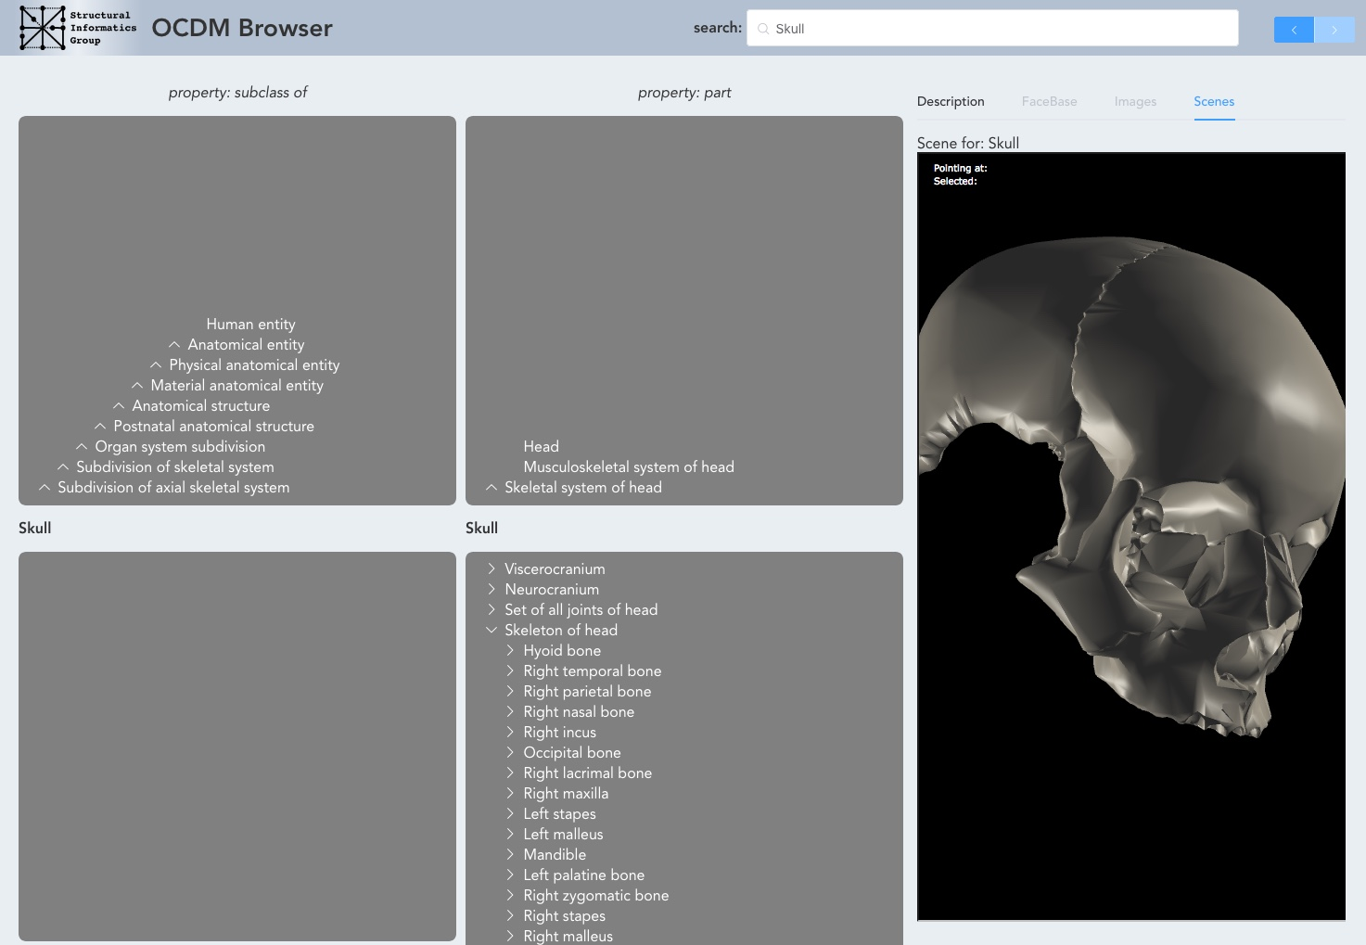

Slide 41
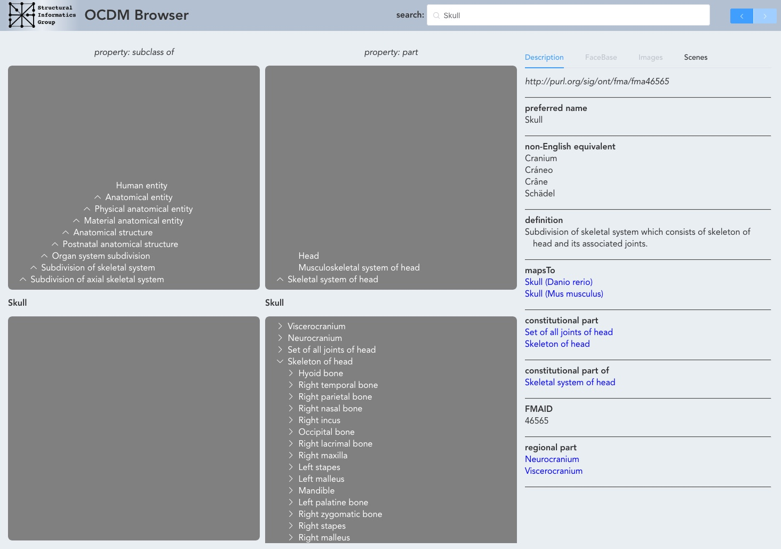

Slide 42
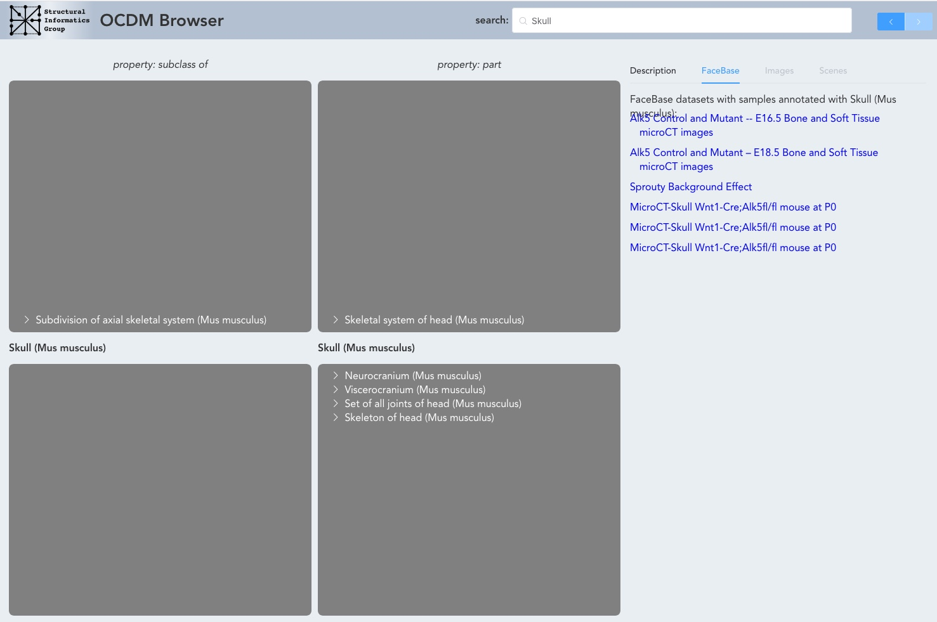

Slide 43
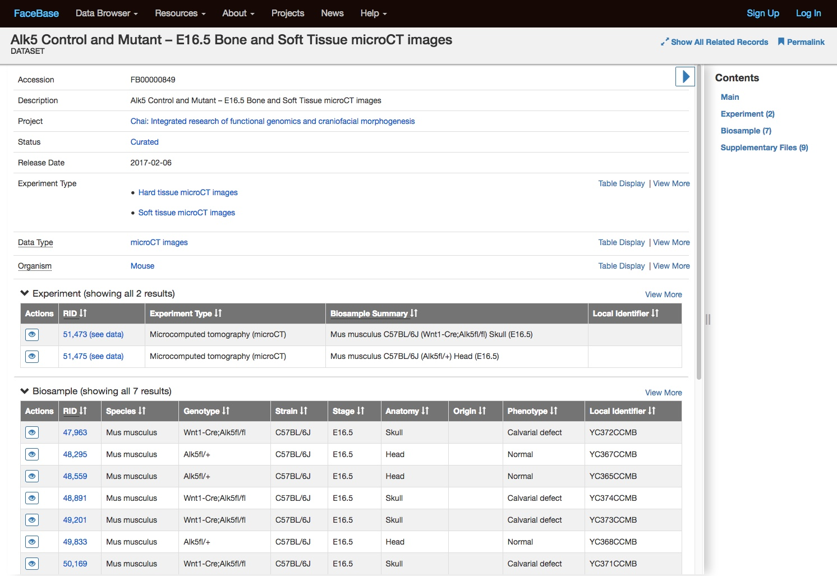

Slide 44
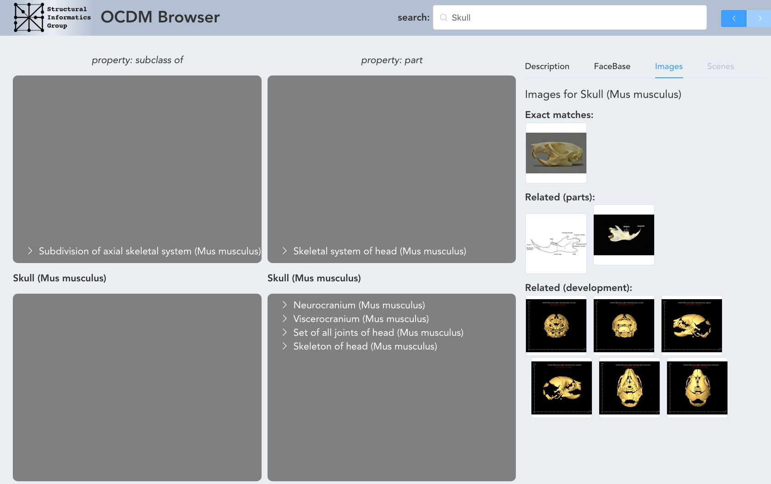

Slide 45
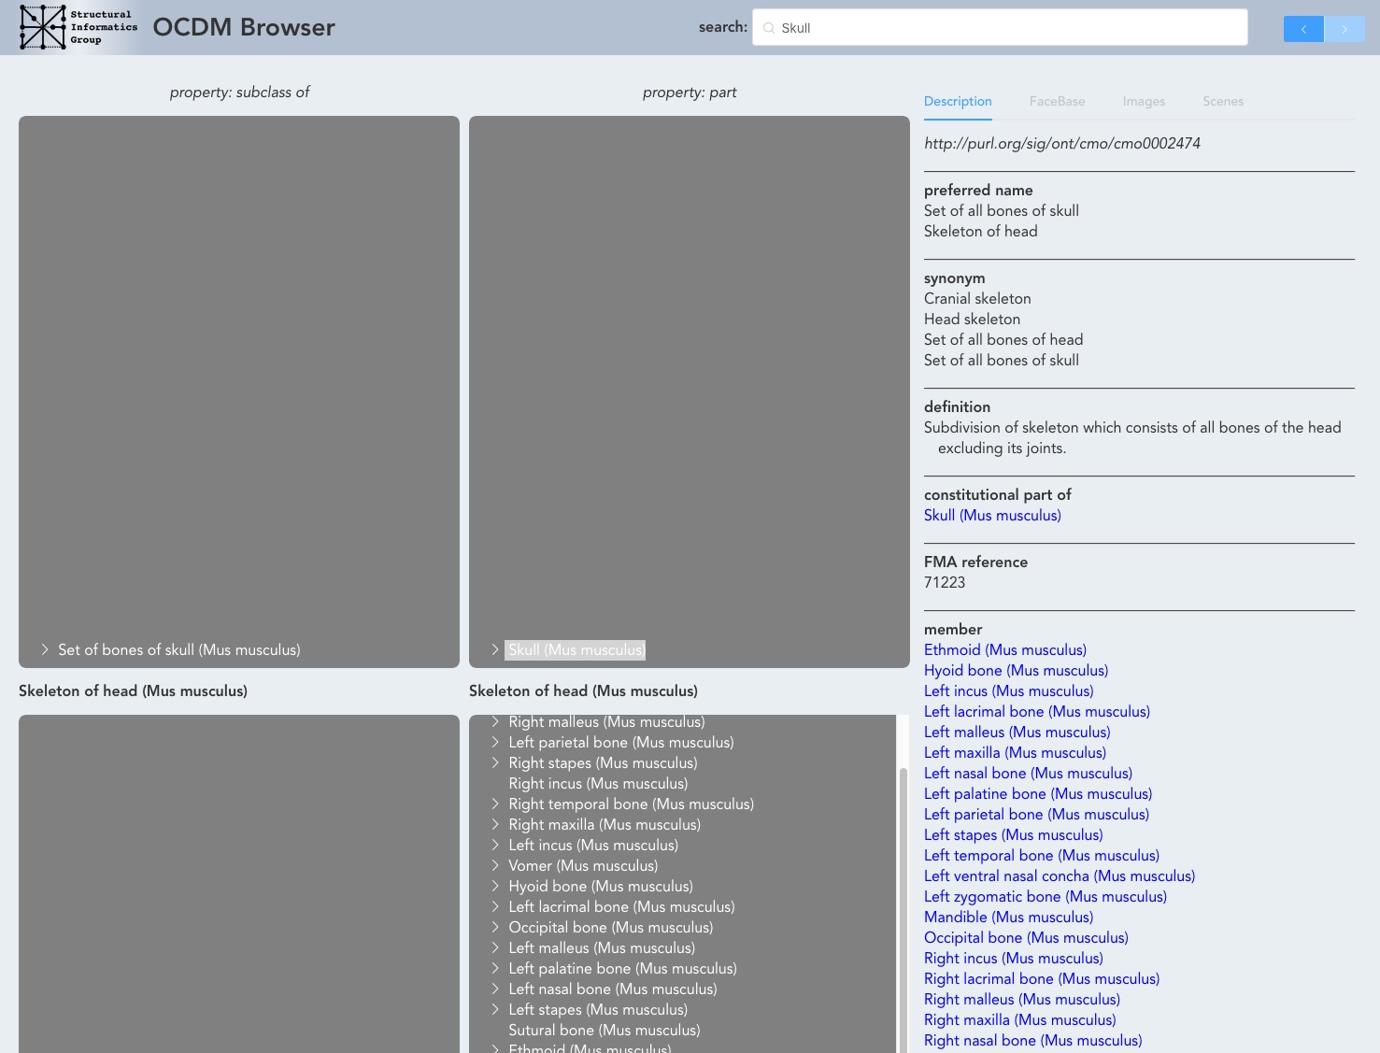

Slide 46
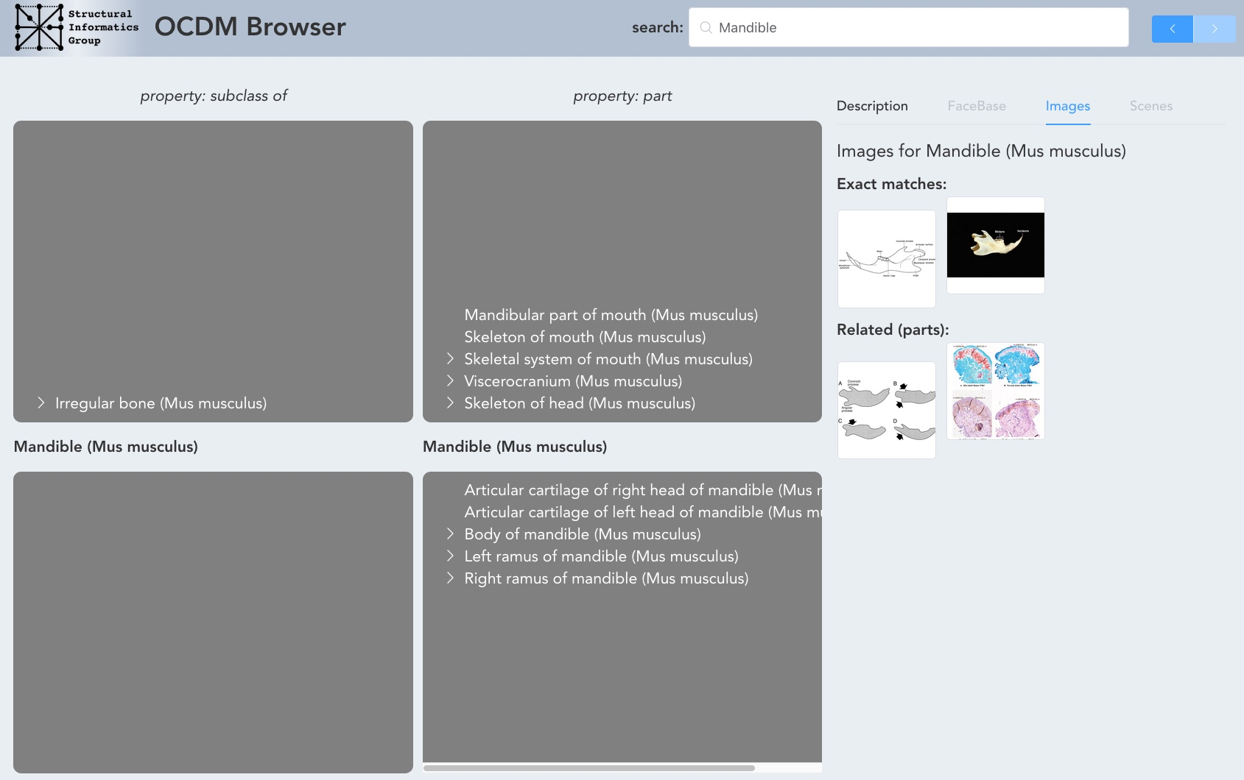

Slide 47
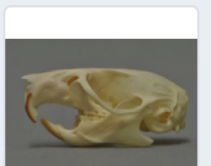
Exact Matches:
Skull (Mus musculus)
Related:
Mandible (Mus musculus)

Slide 48
Exact Matches:
Skull (Mus musculus)
Part of
Skeleton of Head (Mus musculus)
Related:
Has part
Mandible (Mus musculus)

Slide 49
Knowledge Patterns

Slide 51
Summary
Rich, detailed set of terms and relations
Encompasses human, mouse, zebrafish
Ranges from
clinical to research
gross anatomy to genomic
Links to existing “standard” ontologies
Supplements standard ontologies when more details and relations needed

Slide 52
Plans
Maintenance and some new content
SparQL endpoint for queries by other apps
Daily updating of SPARQL endpoint for all changes
Periodic releases
Browser code on Github

Slide 53
Further information
http://www.ncbi.nlm.nih.gov/pmc/articles/PMC4041627/
Facebase https://www.facebase.org/ocdm/
UW Structural Informatics Group www.si.washington.edu/projects/ocdm
Jim Brinkley, brinkley@uw.edu
Onard Mejino, mejino@uw.edu

Slide 54
Artifacts
Latest release http://sig.biostr.washington.edu/share/downloads/ocdm/release/latest/ocdm.zip
OCDM Browser http://ocdm.si.washington.edu/browser
Browser source code
https://github.com/uw-sig/OntTK

