Slide 1


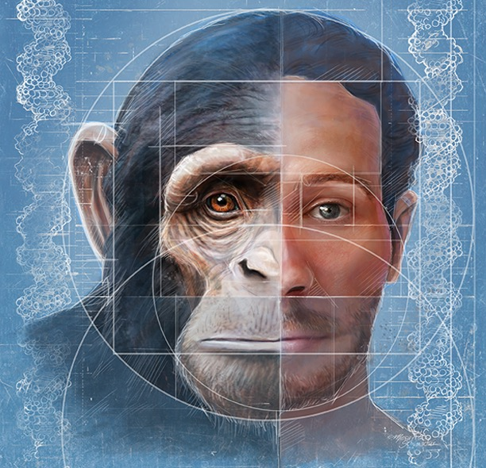
FaceBase2 Spoke
Epigenetic landscapes and regulatory divergence
of human craniofacial traits
Joanna Wysocka & Licia Selleri
(Stanford U. & UCSF)

Slide 2

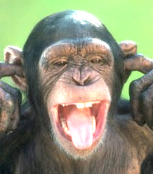



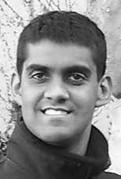
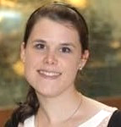


Our Team Members:
Licia Selleri
(UCSF)
Tomek Swigut
(Stanford)
Joanna Wysocka
(Stanford)
Bob Aho
(UCSF)
Jaaved Mohammed
(Stanford)
Hannah Long
(Stanford)
Karissa Hansen
(UCSF)
Ian Welsh
(UCSF)

Slide 3
Our Aims:
AIM 1:
To characterize epigenetic landscapes and transcriptomes of human and chimpanzee Cranial Neural Crest Cells (CNCCs) and to identify conserved and species-speciﬁc cis-regulatory elements
AIM 2:
To analyze activity of candidate craniofacial enhancers in vivo

Slide 4
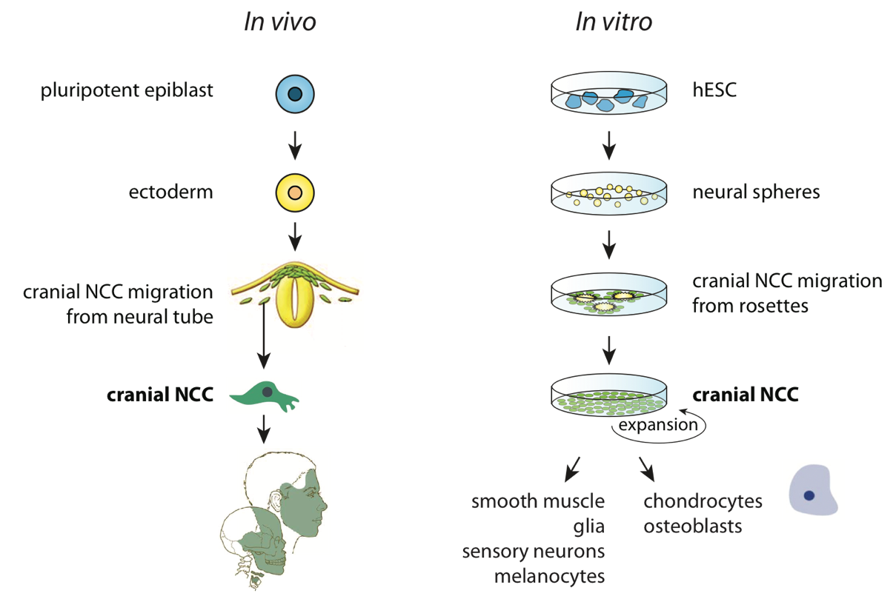
Human Cranial Neural Crest Cells (CNCC) can be derived in vitro from hESC or iPSC
Bajpai et al 2010
Rada-Iglesias et al 2011
Prescott et al 2015
Notes:
Using our robust protocol we can differentiate human pluripotent stem cells into cranial neural crest. Firstly, we induce formation of neural spheres, and allow them to attach to the dish over a period of days. Strikingly, in a beautiful recapitulation of in vivo biology, we observe that stellate neural crest cells emerge from the border of these neural spheres. We can then further proliferate and passage these neural crest cells to a plethora of downstream derivatives including chondrocytes.

Slide 5
Epigenomic strategy for systematic annotation of human cranial neural crest regulatory elements
p
Human Cranial Neural Crest Cells
ChIP-seq, ATAC-seq, RNA-seq
p300
transposase
TFs and general
coactivators
ATAC
(hypersensitivity)
H3K4me1
H3K27ac
H3K4me3
p300, hypersensitivity
H3K27ac
H3K4me1
Enhancer signature
Promoter
signature
Gene expression (RNA-seq)
Notes:
And we used such epigenomic strategy to first map occupancy of general coactivator proteins, hypersensitivity, and histone modifications characteristic of active cis-regulatory elements, and then based on simple chromatin signatures we annotated genomic positions and distinguished active enhancers and promoters in CNCCs.

Slide 6
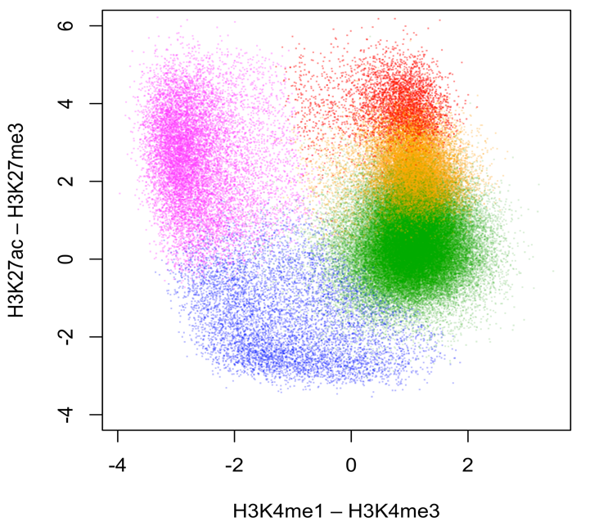
Chromatin maps can identify and separate different classes of regulatory elements
promoters
enhancers
strongly active
weakly active
inactive regulatory
regions
poised/primed

Slide 7
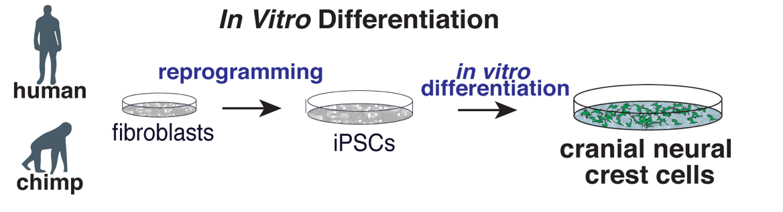

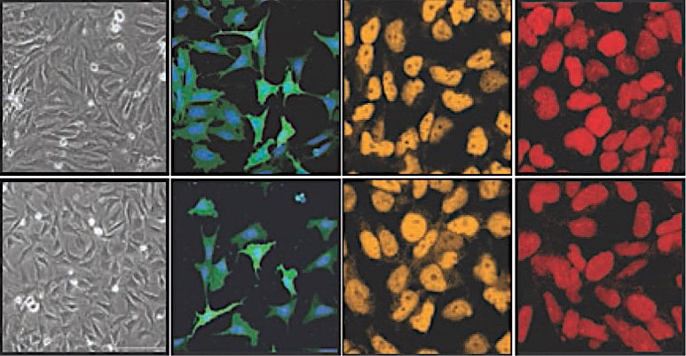
In vitro derivation of cranial neural crest cells from chimpanzee iPSC
Sara Prescott
BF
P75/DAPI
AP2a
NR2F1
human CNCCs
Prescott et al, Cell, 2015
chimpanzee CNCCs
p75+, TFAP2A+, TWIST1+, SOX9+, SOX10+, DLX1/2+, HOX-
Notes:
Furthermore, in our most recent unpublished work, we were able to extend this model to the non-human primates, such as the chimpanzee (and we have characterization of bonobo and gorilla in progress).
This became possible with the advent of reprogramming, as now we can take fibroblasts from different apes, reprogram them to the iPSC and use these pluripotent cells for CNCC derivation. Importantly, these in vitro derived chimpanzee have morphology and key marker gene expression equivalent to the human cells, and we have done extensive validations to ensure that we can properly stage cell populations from both species.
So now we have a very unique model in hand – basically primate equivalent of a cell type that we know from the avian embryo experiments is most relevant for determining species-specific facial variation.
What do we do with it if we want to understand HOW it encodes species-specific morphology?

Slide 8
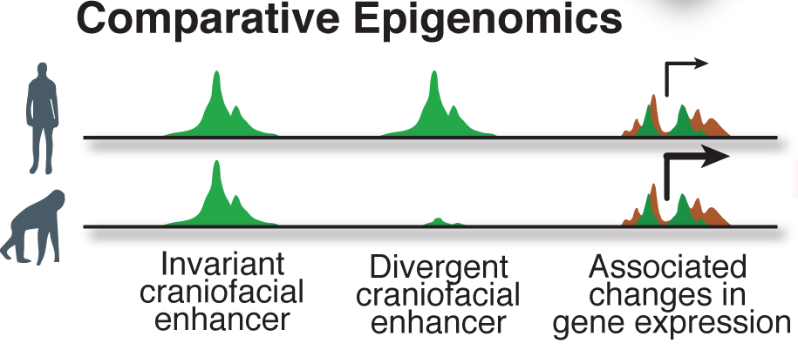
Using epigenomics to experimentally map regulatory divergence in human and chimp cranial neural crest cells
p
Notes:
We then used our epigenomic predictions to experimentally map regulatory divergence in human and chimp neural crest cells.
The idea here that most active enhancers should be invariant, as this is the same cell type compared between two closely related species with highly similar genomes.
However, we were also hoping to discover enhancers with species-biased activity, which could come either as a consequence of structural variation between the genomes, at regions with no clear orthology, or through the quantitative change at highly orthologous regions.
I want to point out the power of our system in detecting this second type of variation, which as you will see in a few minutes appears to be the primary mechanism of enhancer activity divergence. Structural variation can be studied by comparing two genomes in the absence of functional data, for example by identifying human-specific deletions spanning conserved non-coding elements
However, we can only measure quantitative changes at orthologous regions with experimental data from a relevant cell type- in this case cranial neural crest cells

Slide 9
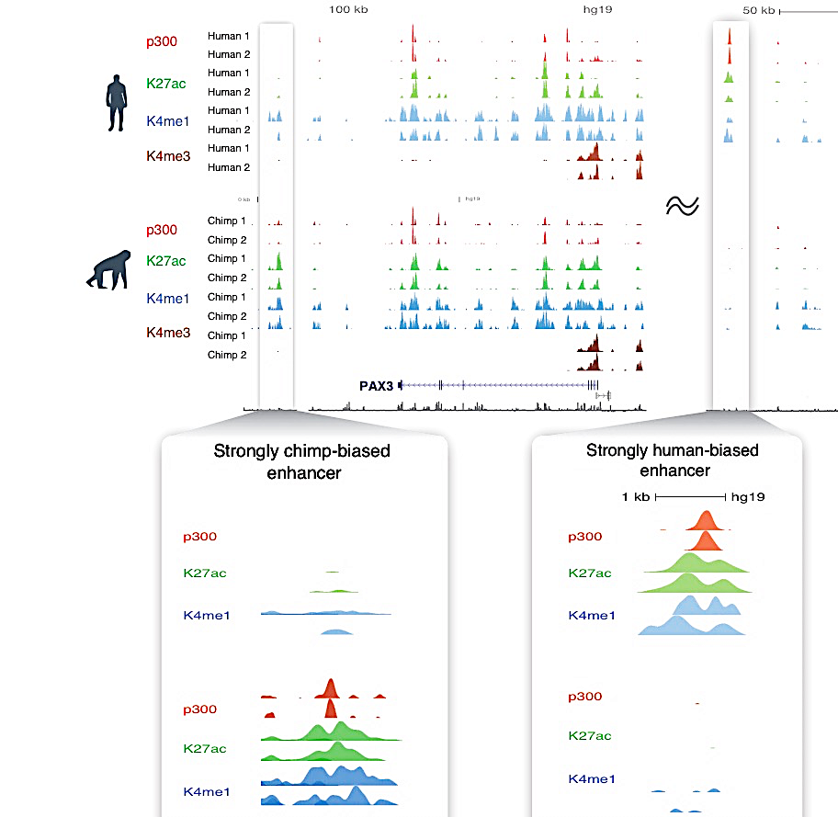
Discovery of candidate species-biased enhancers
Notes:
So how do the actual data look like?
As expected most of the epigenomic patterns are invariant between the individuals of the same species and also between the species. However, I wouldn’t be telling you about this, if there weren’t also important differences, as exemplified here with a genome-browser representation of ChIP-seq tracts showing strong bias of coactivator binding and active enhancer marks that is either chimp-specific or human-specific.

Slide 10
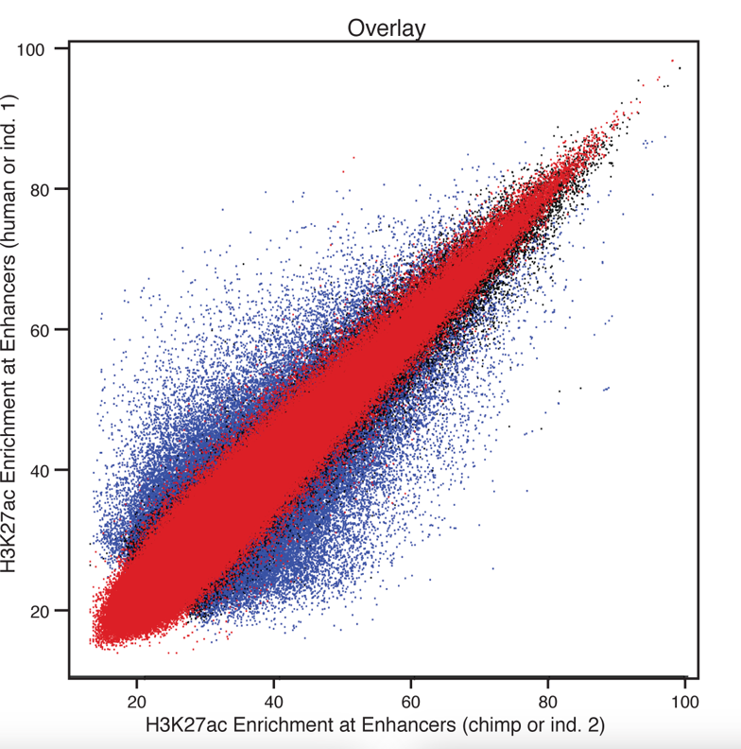
Quantitative epigenomic comparisons at orthologous regions identify species-biased candidate enhancers genome-wide
human-biased
H3K27ac at Human Enhancers
chimp-biased
H3K27ac at Chimp Enhancers
Notes:
We can perform such quantitative epigenomic comparisons of enhancer chromatin signatures genome wide, identifying variation of signal between different individuals of the same species, or comparing individuals of different species. I am showing you here such comparisons for the H3K27ac acetylation signals, which we have previously shown are well-correlated with enhancer activity, but the results hold if we use other measures of enhancer state, such as coactivator or TF binding
As you can hopefully appreciate from these representations, the level of variation in epigenomic enhancer signatures in much higher when comparing human and chimpanzee, than when comparing individuals of the same species, allowing us to identify human-biased and chimp-biased CNCC enhancer elements genome-wide

Slide 11
Genomic datasets generated by our project:
ChIP-seq from human and chimpanzee in vitro derived CNCC:
H3K4me1, H3K4me3, H3K27ac, H3K27me3,
p300, AP2a, NR2F1
ATAC-seq from human and chimpanzee CNCC
RNA-seq from human and chimpanzee CNCC
Altogether, 74 datasets from our project have been submitted to the Facebase

Slide 12
Our Aims:
AIM 1:
To characterize epigenetic landscapes and transcriptomes of human and chimpanzee Cranial Neural Crest Cells (CNCCs) and to identify conserved and species-speciﬁc cis-regulatory elements
AIM 2:
To analyze activity of candidate craniofacial enhancers in vivo

Slide 13
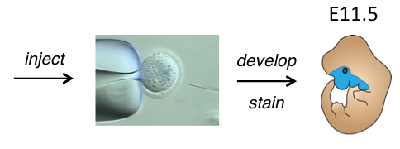
Design for in vivo transgenic assay
Measure enhancer activity by staining Tg mouse embryos for β-galactosidase activity

Slide 14
Prioritization of candidates for transgenesis:
candidate enhancers with strong changes in regulatory activity between humans and chimps (as determined in CNCCs)
candidate enhancers within loci associated with human craniofacial disorders

Slide 15
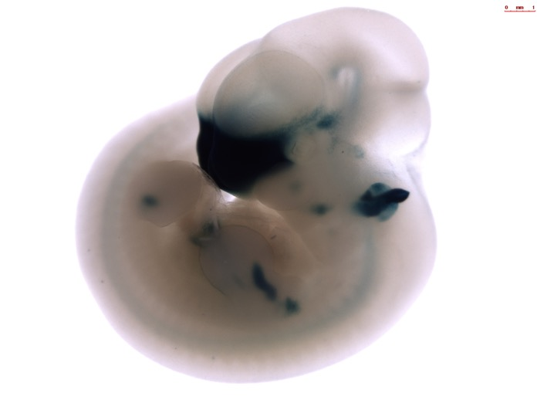
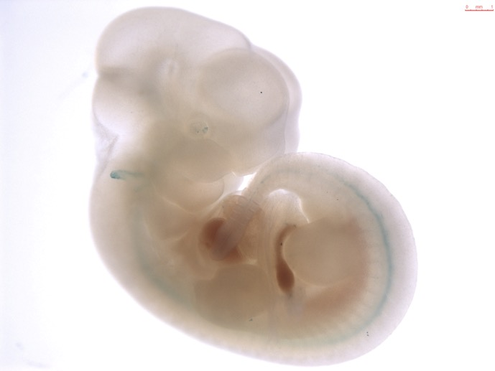
Example 1: predicted human-biased
Closest gene: FAM222A
Family With Sequence Similarity 222 Member A
Karissa Hansen
Licia Selleri

Slide 16
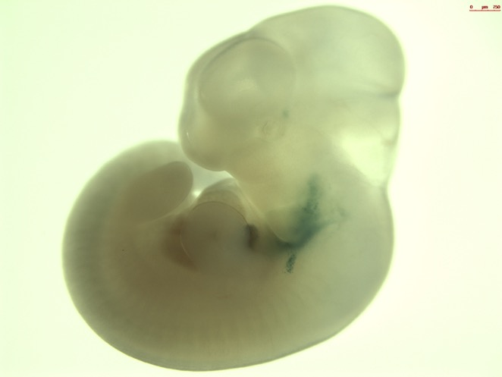
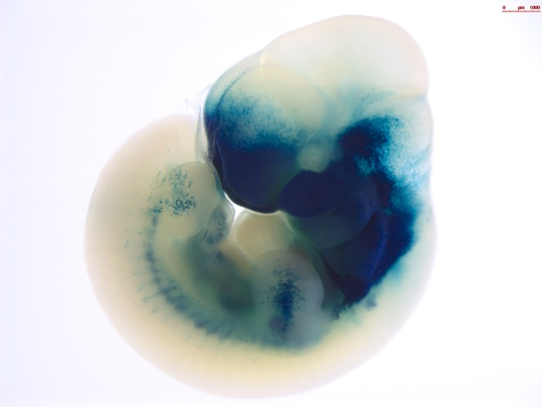
Example 2: predicted chimp-biased
Closest gene: BBS9
Nearby craniofacial gene: BMPER
Bardet-Biedl Syndrome 9
BMP-binding endothelial regulator
Karissa Hansen
Licia Selleri

Slide 17
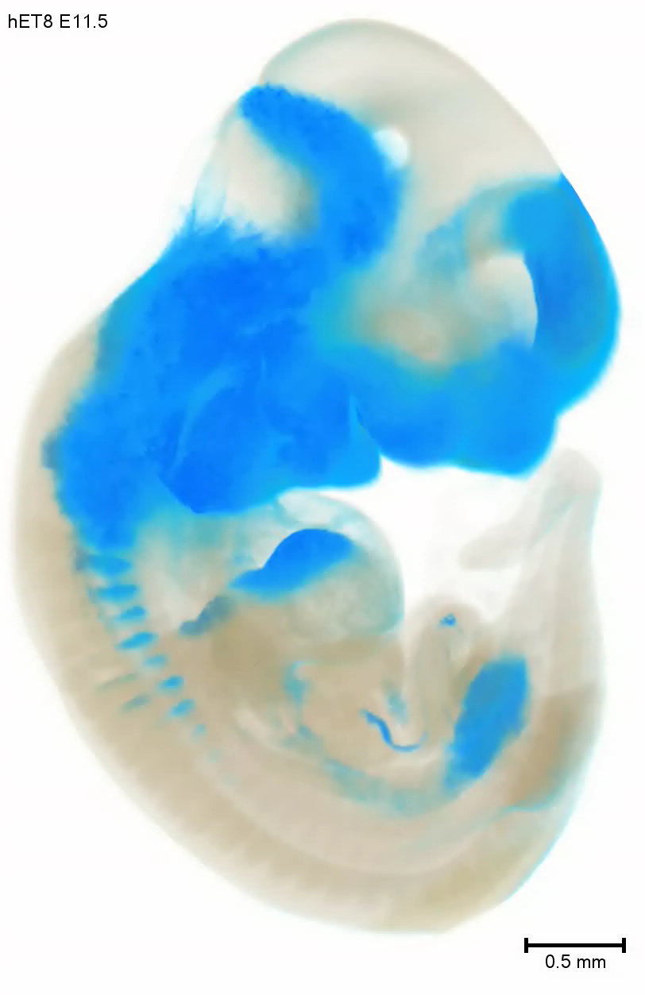
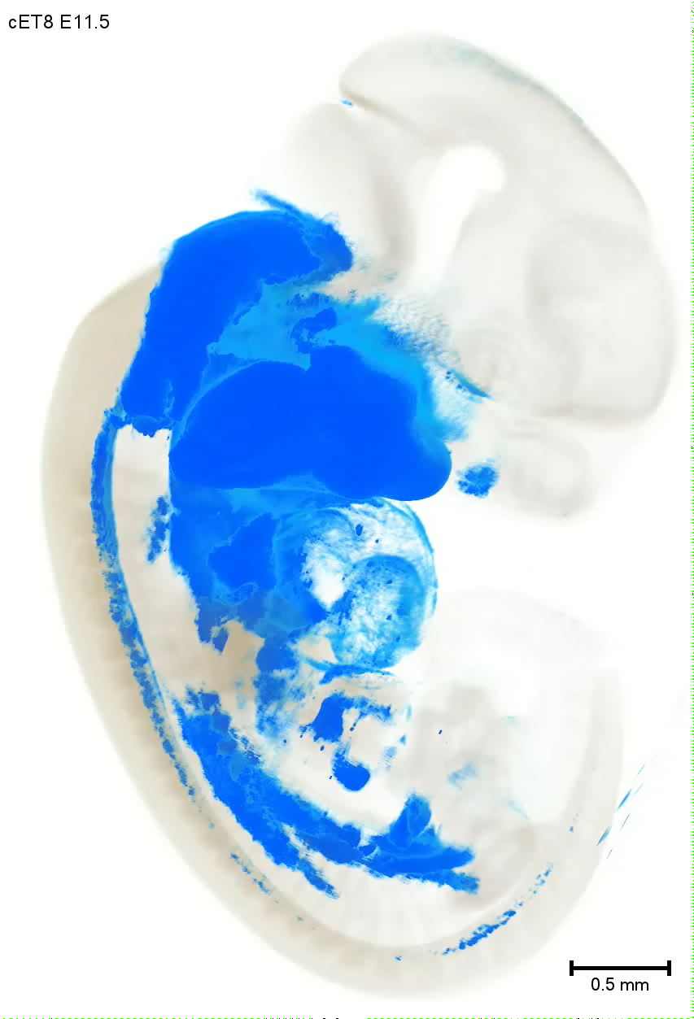
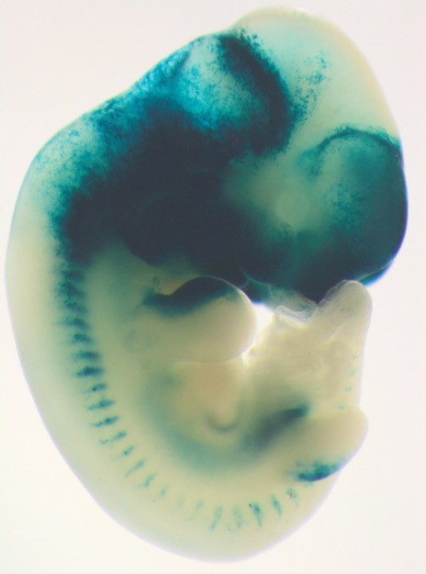
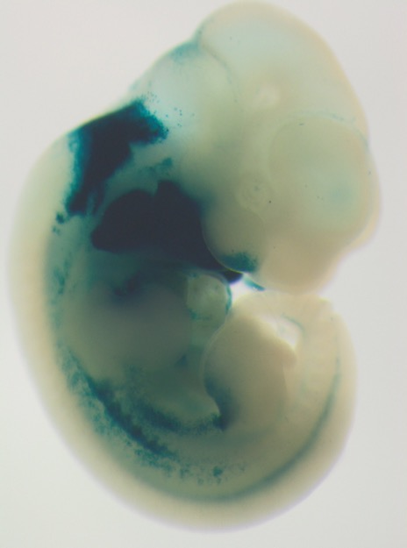
Example 3: predicted human-biased
Difference in activity within specific regulatory domain
High-Resolution Episcopic Microscopy
Karissa Hansen
Licia Selleri
Regeneron

Slide 18


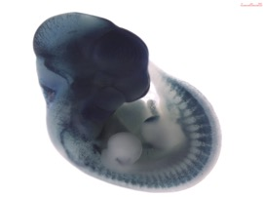
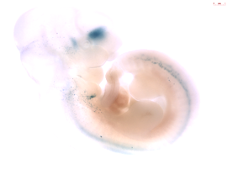
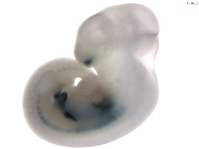
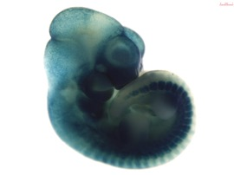
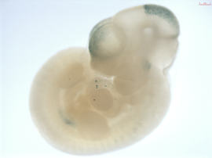
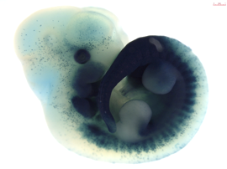
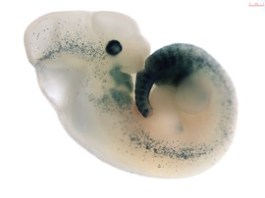
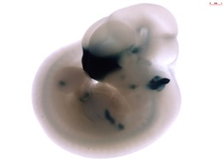

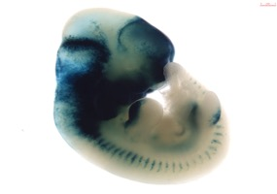
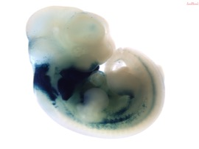
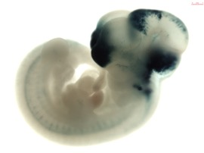
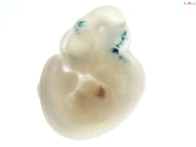
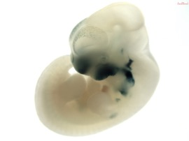
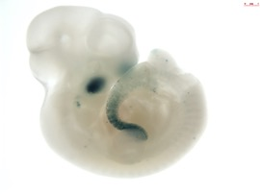
Enhancer bias repeatedly followed predictions
BMPER
ET3
ET4
ET5
ET6
ET7
ET8
ET12
ET26

Slide 19
Reaching U01 Milestones
All injections proposed in original milestones have been completed
59 constructs have been tested, totaling 100 injections
Out of 17 constructs where human and chimp orthologs have been tested, 14 demonstrate the predicted bias
=82%

Slide 20
Original milestones for both aims of our FaceBase project have been met!
AIM 1:
To characterize epigenetic landscapes and transcriptomes of human and chimpanzee Cranial Neural Crest Cells (CNCCs) and to identify conserved and species-speciﬁc cis-regulatory elements
AIM 2:
To analyze activity of candidate craniofacial enhancers in vivo

Slide 21
What can these datasets be useful for?
Studying regulation of key craniofacial genes
Insights into human regulatory evolution
Interpretation of craniofacial GWAS
Understanding non-coding regions involved in human craniofacial malformations

Slide 22
What can these datasets be useful for?
Studying regulation of key craniofacial genes
Insights into human regulatory evolution
Interpretation of craniofacial GWAS
Understanding non-coding regions involved in human craniofacial malformations

Slide 23
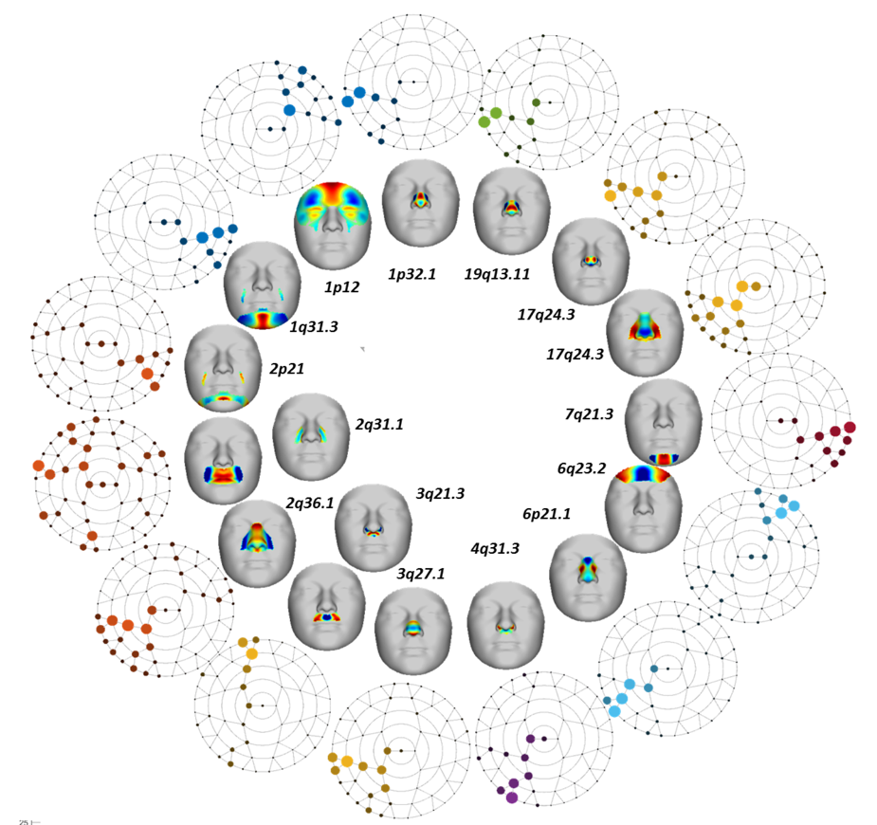
GWAS uncovered/replicated 15 loci associated with different aspects of facial variation in Europeans
Claes et al., Nature Genetics, 2018
Peter Claes (U. Leuven)
Mark Shriver (Penn State)
Seth Weinberg (U. Pittsburgh)

Slide 24
GWAS regions are preferentially marked by active chromatin marks in CNCCs
(suggesting developmental origin of captured facial variation)
other embryonic, adult or in vitro derived cell types
in vitro derived hCNCCs
Claes et al., Nature Genetics, 2018

Slide 25
Lead SNPs identified in facial variation GWAS are enriched in vicinity of CNCC enhancers
promoters
enhancers
strongly active
weakly active
poised/primed
inactive regulatory regions

Slide 26
Thank you!
Collaborators:
LBNL:
Axel Visel
Marco Osterwalder
Diane Dickel
Licia Selleri
Karissa Hansen
Ian Welsh
Bob Aho
Tomek Swigut
Hannah Long
Jaaved Mohammed
Sara Prescott
Peter Claes (U. Leuven)
Mark Shriver (Penn State)
Seth Weinberg (U. Pittsburgh)
Tim Mohun (Crick Institute)
Our colleagues from Hub and other Spokes
Cristina Williams
NIDCR staff
Steve Scholnick
Emir Khatipov
Kathryn Stein

