Slide 1
Welcome to FaceBase Bootcamp
FaceBase 2024 Bootcamp for Users and Contributors

Slide 2
Demo: Website and Documentation
Website
https://www.facebase.org
Documentation
https://docs.facebase.org

Slide 3
Finding, Accessing & Citing Data
FaceBase 2024 Bootcamp for Users and Contributors
Notes:
In this next part of the presentation, I’ll show you how to find, access, and cite data from facebase.

Slide 4
An Analogy… Shopping for a Car Online
Google vs. Cars.com? “2018 or newer Mazda MX-5 Miata with less than 20,000 miles near 90292”
vs?
Text search works well over a collection of documents, not as well for non-text objects
Notes:
For starters if we can just step back and reflect on our experiences of searching for something on the web.
Finding data online is a bit different than searching for documents and web pages.
When it comes to text documents and webpages, a typical web search engine (like Google) does a great job of finding something relevant to your free form key words search.
However, locating something very precise, especially if its not a document or webpage generally doesn’t work as well.
In some ways searching for data is a lot more like online shopping – where you are looking for something specific and often it’s a physical object like a car or clothes.
Again reflecting on our own experiences searching the web, lets take for example the search text here for “2018 or newer Mazda…” How well would that work?
The alternative are sites specifically dedicated to shopping or specific to a type of product (like a car).

Slide 5
"Faceted Navigation" through Structured Data
Filters by category
Guides the “search” through structured data by their classification or characteristics
Notes:
When doing online shopping you are actually encountering a technology called “Faceted Navigation”.
In simple terms, this is your typical “Search and Refine” experience. Where you might start by entering a key word search and then refine with with filters-by-category.

Slide 6
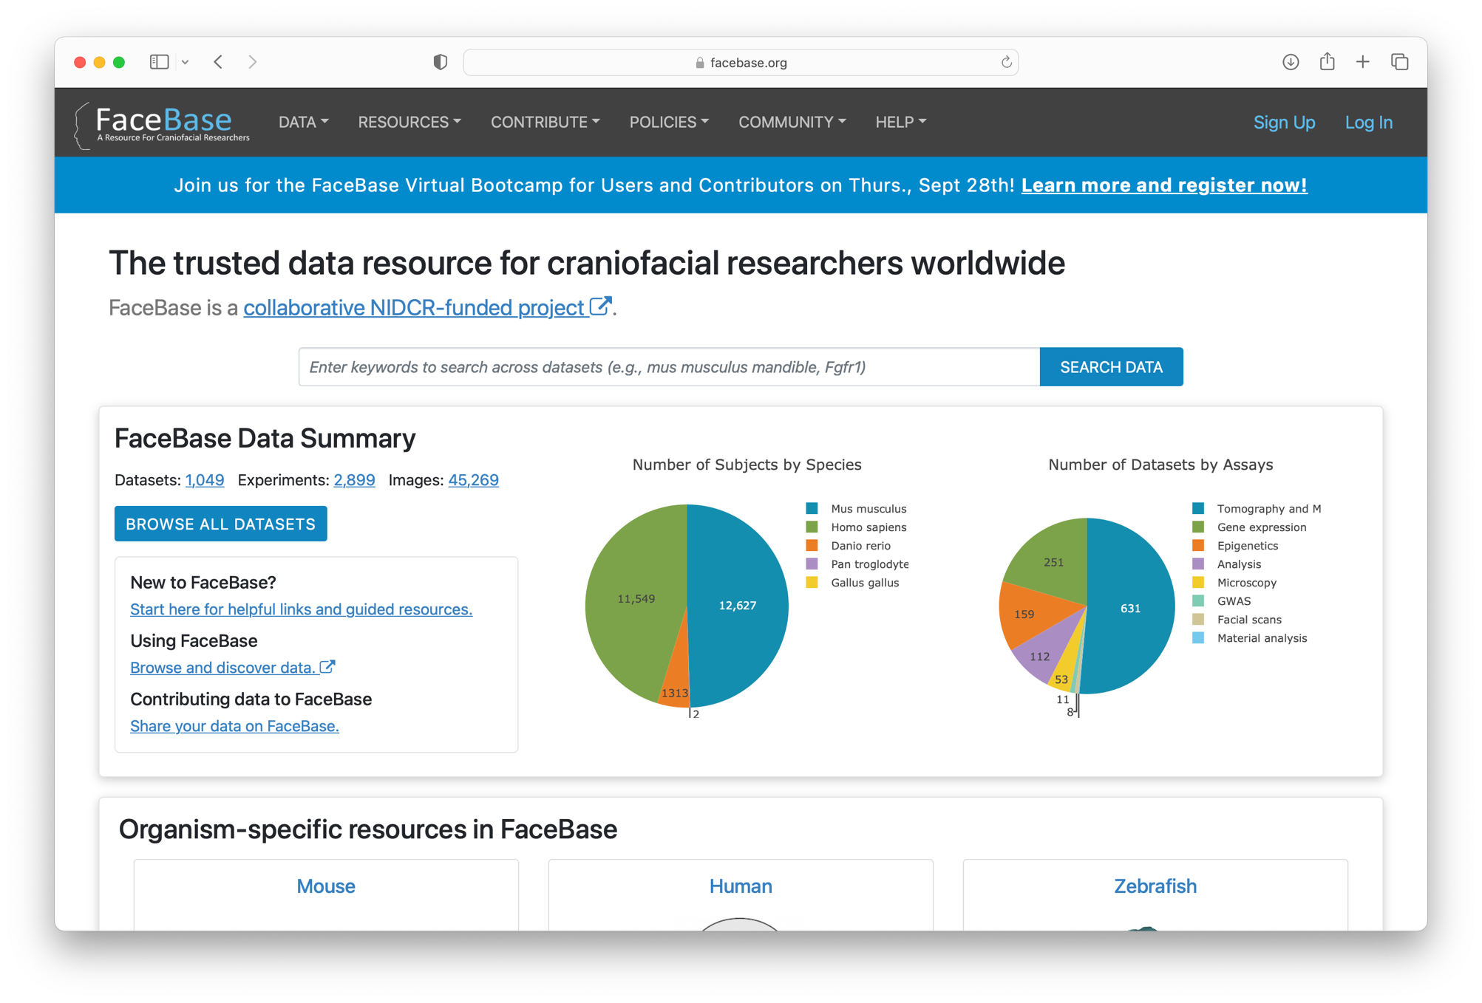
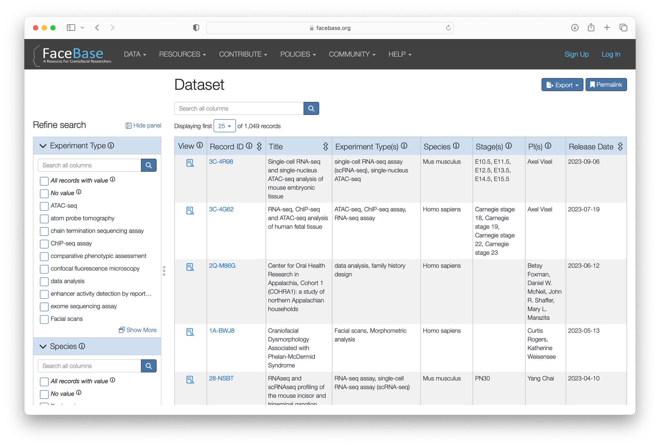
Finding Data in FaceBase
Search & Browse
Filters by category
Guided search through the project-dataset-experiment-biosample data model
Notes:
FaceBase follows this “faceted navigation” (ie, search & refine) paradigm for finding data.
We’ll see in a moment as we move to the online demonstration that the facebase home page has a search bar at top (or a browse all data link) and then when it presents the results it gives you a number of filters by various categories relevant to the data.

Slide 7
Ready for Reuse, Reproducibility, (Re)analysis
Represents the group contributing data, funding, and team members
Describe or reference protocol(s)
Collection of data and metadata
Specifies assay type, protocol used, instruments, etc for each experiment.
Provides details about the tissue: species, genotype, age stage, anatomy, etc.
Collects data output: imaging, microscopy, sequencing and others…
Based on “FAIR data” principles, for increased scientific utility
Notes:
Its also important to pause for a moment and also know FaceBase data are organized in a structured, intuitive data model.
This helps to ensure that FaceBase data are ready for reuse, reproducibility, and (re)analysis.
From top to bottom, a Project is…
This structured information is what powers the search & browse experience, behind the scenes.

Slide 8
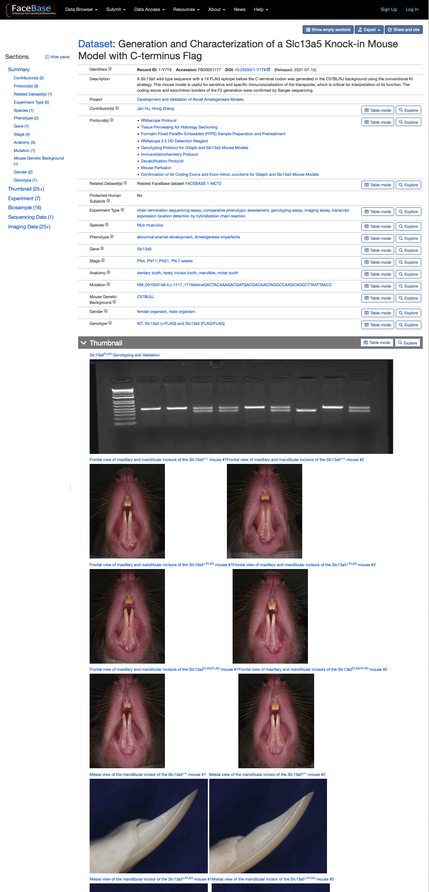
Tour of Dataset Details
Persistent Identifiers (e.g., Digital Object Identifiers)
Protocols
Keywords
Standardized Terminology
Additional Details
Notes:
When you find data of interest, then your drill down to a dataset and you can view its detailed information (aka, metadata) that describe the data.
On the right hand side is a large thumbnail of just the top part of a dataset details page.
In the highlighted region you can see the most high level descriptive information like its Title, Description, Attribution, etc.
In particular, I’d like to point that every dataset is given a Digital Object Identifier (DOI) just like any journal publication. This ensures the long term citability of FaceBase data.
Datasets also include protocol documents for in-depth explanation of the experimental procedures that produced the data (or analyses).
A set of keywords such as the experiment type (assay), species, anatomical regions, phenotypes, syndromes, and several others help to categorize the data – again to ensure the findability of the data.
These almost always come from “standardized terminology” sources. That way data are described consistently even across different datasets produced by different contributing projects.

Slide 9
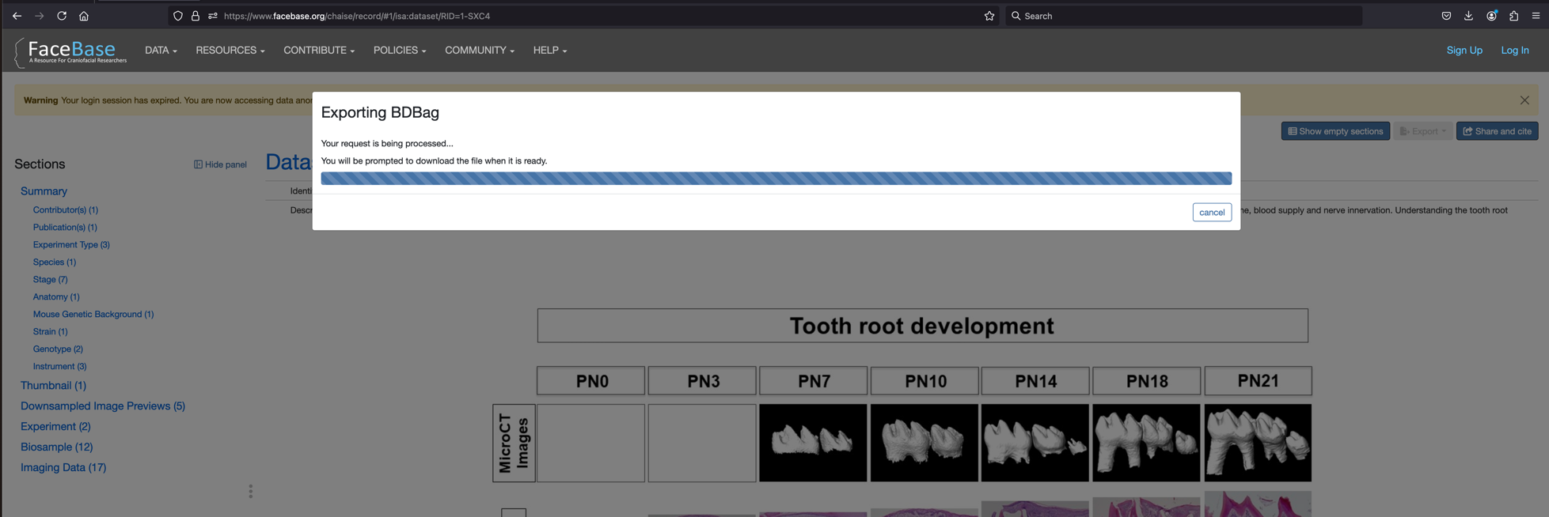
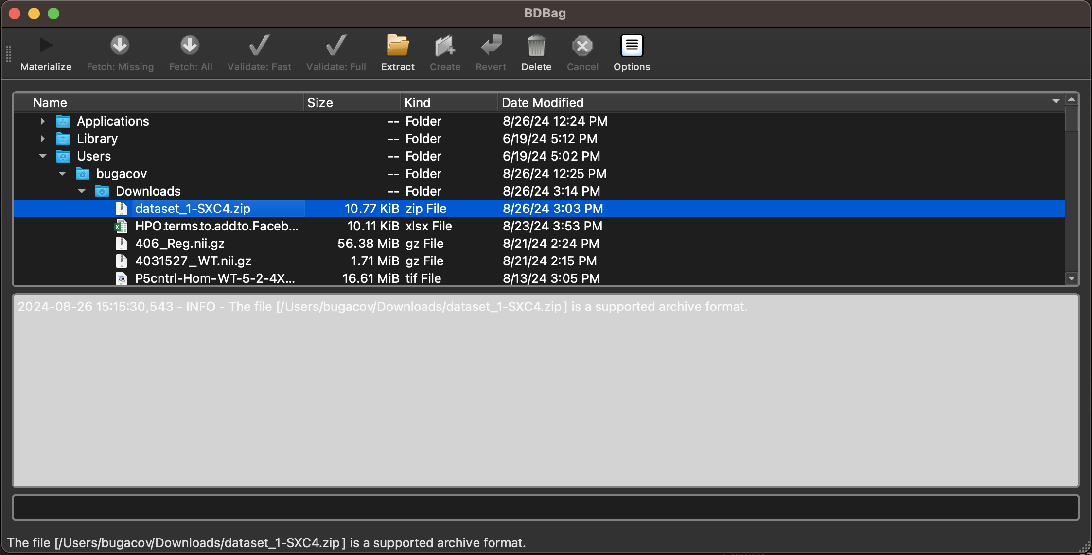
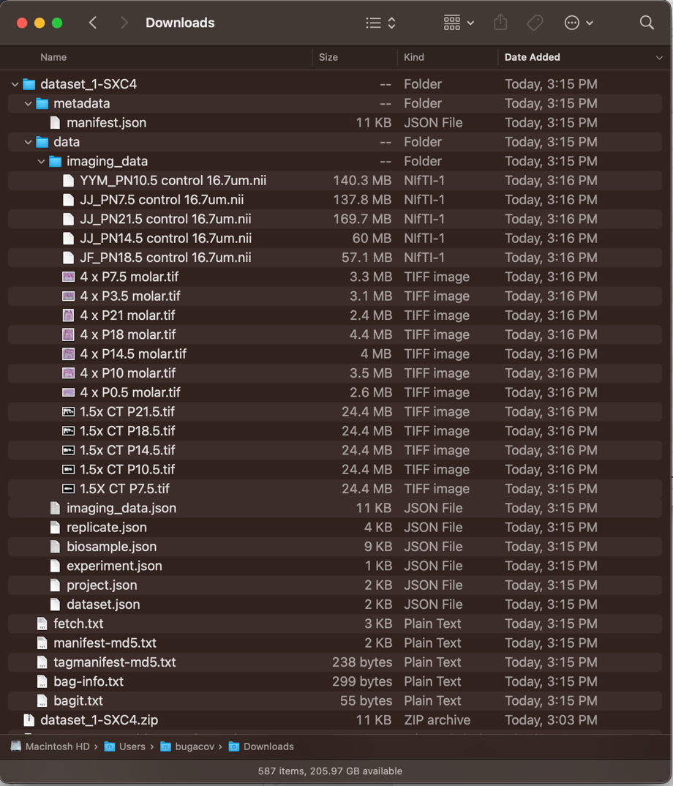
Batch Data Export
Download a dataset manifest file (BDBag) using the browser
1
Desktop applications for large data downloads
Materialize – fetch and integrity check data files
2
All files downloaded to your computer
3
Notes:
Now, you can actually download all of the open access FaceBase data right from any web browser. You don’t even need to log in.
Later, Alejandro will show you how to request our controlled access data. But for any of our non-human subjects data, you can get it right from the website directly using your browser. You don’t even need to install any special software or even create a user login account.
But in the event you want to download large amounts of data – say for a large sequencing experiment or even large high resolution imaging datasets – it can be tedious to download them one-by-one using your web browser.
To make it easier, we have a desktop (and command line tool) that you can install. Then you just download a “manifest file” from the dataset page. Next using the download tool you “materialize” the dataset (which means it does a robust, efficient download and does integrity checks as it does, and it can restart failed downloads too).

Slide 10
Programmatic Data Access
Programmatic access to all data using Python and R APIs
Notes:
You can also access any and all data from the FaceBase site using our programmatic APIs in Python and R programming languages.

Slide 11
Citing Datasets In Publications
Citable Data IDs:
Globally-unique
Persistent
Actionable
Versioned
Publishable
Cite data as you would any other work that you use
Always include the DOI! ☺
Recommended Citation Format for Data
Notes:
When you’ve used/reused FaceBase data in your own research, you should of course *cite* the datasets that you used. This is just as important as citing publications as a way of a recognizing the research you are building on.
There are guidelines offered by major publishers. We recommend following Nature, Science, or your particular publication venue if they have their own guidelines.
For every dataset in FaceBase you will see a ”Share and Cite” button in the upper right corner. Click that and you will see a Share and Cite dialog exactly like seen here in the screenshot.
For citation purposes in your own written works, we provide both a formatted data citation following Nature’s guidelines, and a downloadable “BibTex” file that you can directly import into practically any reference manager software.
We also have online guides on our website that provide more information and links to publisher recommendations.

Slide 12
Demo: Search & Browse & Visualization
General Search
www.facebase.org → Search Data OR Browse All Datasets
Image Search
www.facebase.org → Data → Images
Visualization Examples
Image Volume
https://www.facebase.org/id/TKT (skull)
https://www.facebase.org/id/1-SXC4 (dental)
Histology
https://www.facebase.org/id/1-W96W
Surface Model/Mesh
https://www.facebase.org/id/1-YQK8
Genome Browser
https://www.facebase.org/id/TMJ
https://www.facebase.org/id/1-7780
Single Cell
https://www.facebase.org/id/R-PPWJ
https://www.facebase.org/id/V-J7QP (direct)
Notes:
Mandible + sequencing
Mandible + microscopy

